Slide 1
GCSE GERMAN
Einfach das Beste!
Click the heart to listen!

Slide 2
EBacc
You can only choose a language you have learnt in KS3

Slide 3
Why choose a language?
Job opportunities
education
translation/interpreting
business and trade
government and diplomacy
travel and tourism
journalism
charity

Slide 4
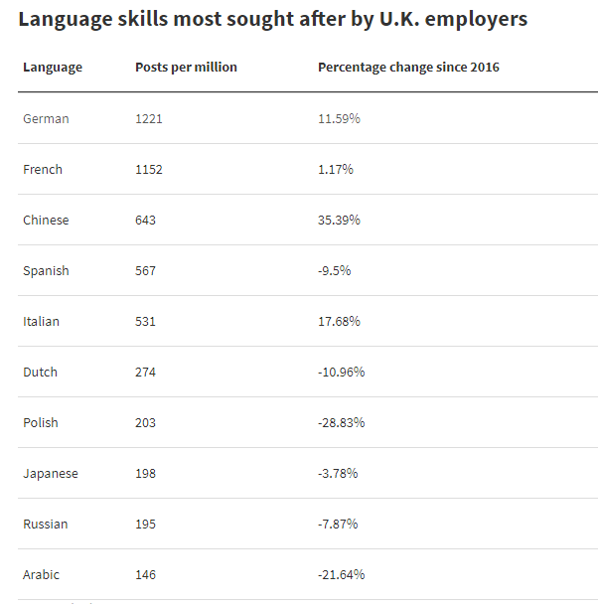

Slide 5
Position | Language | Average Salary
1 | German | £34,534
2 | Arabic | £34,112
3 | French | £32,646
4 | Dutch | £29,423
5 | Spanish | £29,262
6 | Japanese | £28,954
7 | Russian | £28,858
8 | Italian | £28,723
9 | Mandarin | £28,268

Slide 6
Why choose a language?
Further education opportunities
Language/Joint honours degrees
Some universities require you to have an MFL
GCSE (UCL, Russell Group, Oxford, Cambridge) even if you
want to study an unrelated subject
College applications

Slide 7
Why choose a language?
Travel opportunities
Broaden your horizons
Show off

Slide 8
Course Outline

Slide 9
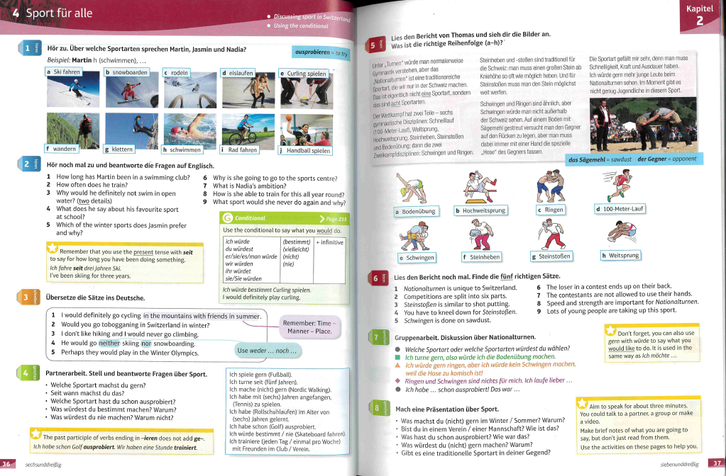
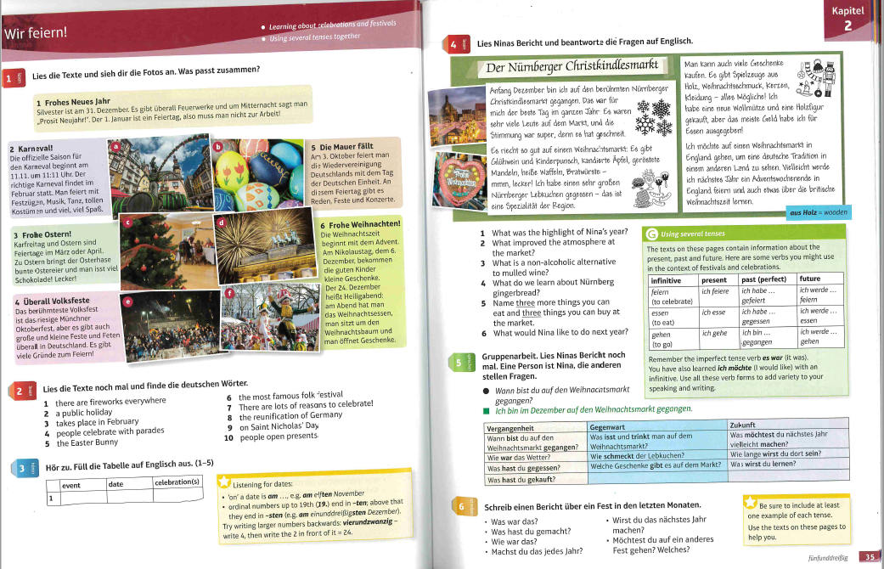
Course Outline
3 Themes
Theme 1: Identity and culture
family and relationships
technology
free time activities
customs and festivals

Slide 10
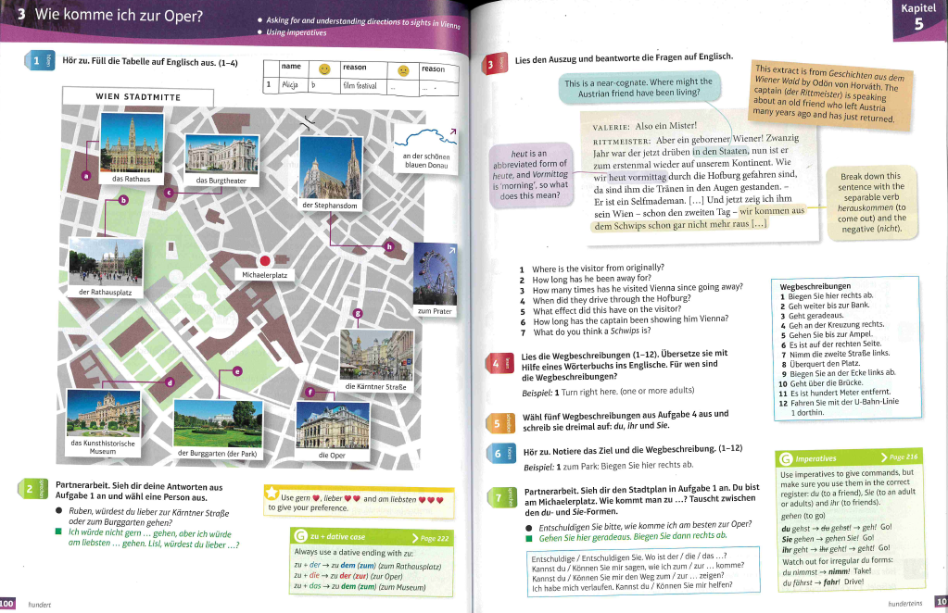
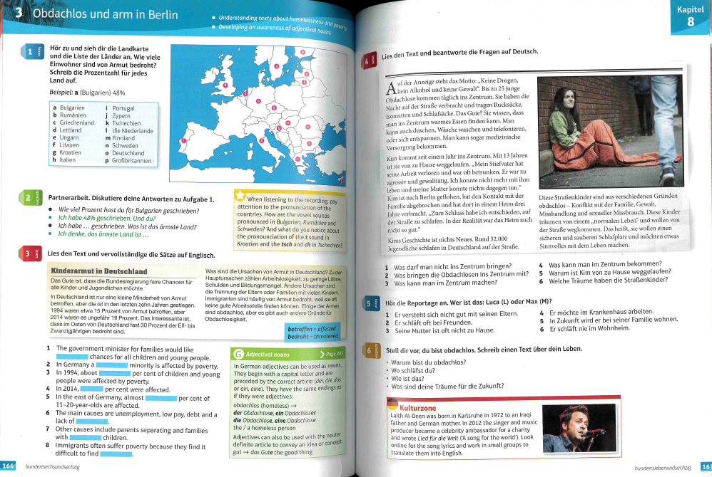
Course Outline
3 Themes
Theme 2: Local, national, international and global areas of interest
home, town and local area
healthy living
global issues – environment, poverty
global events
travel and tourism

Slide 11
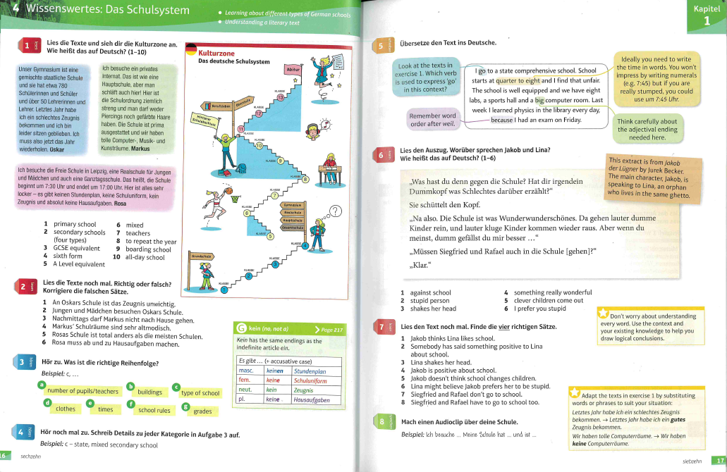
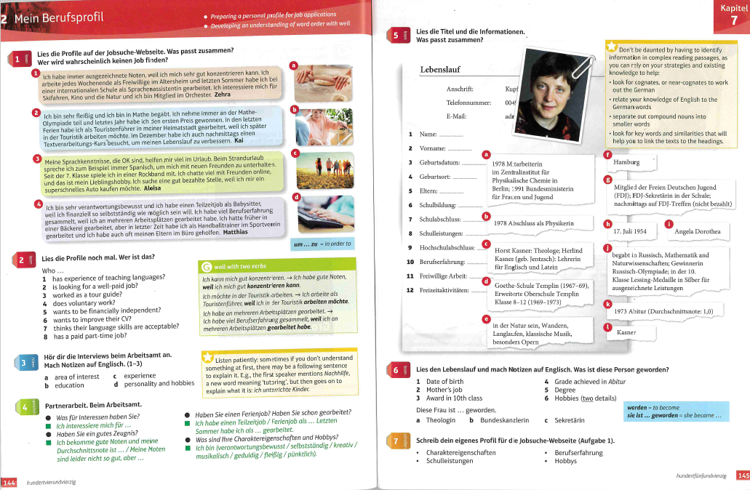
Course Outline
3 Themes
Theme 3: Current and future study and employment
my school
plans for the future, education post 16
work

Slide 12
How is German assessed?
AQA
Higher and foundation tier
4 exams at the end of Year 11
Speaking 25%
Listening 25%
Reading 25%
Writing 25%

Slide 13
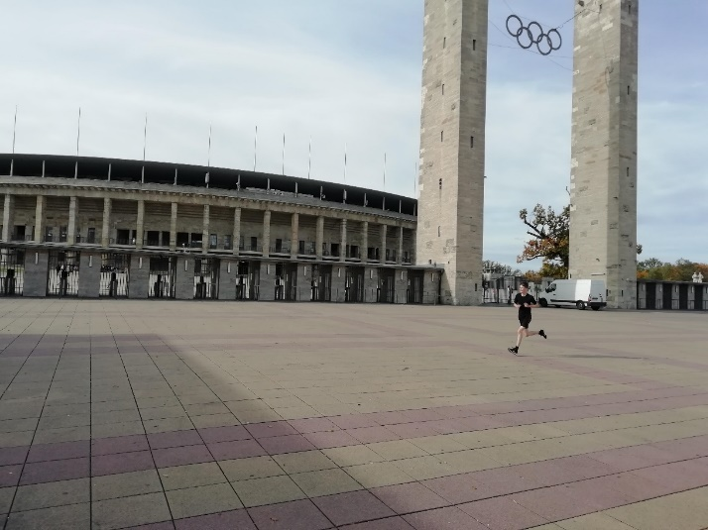
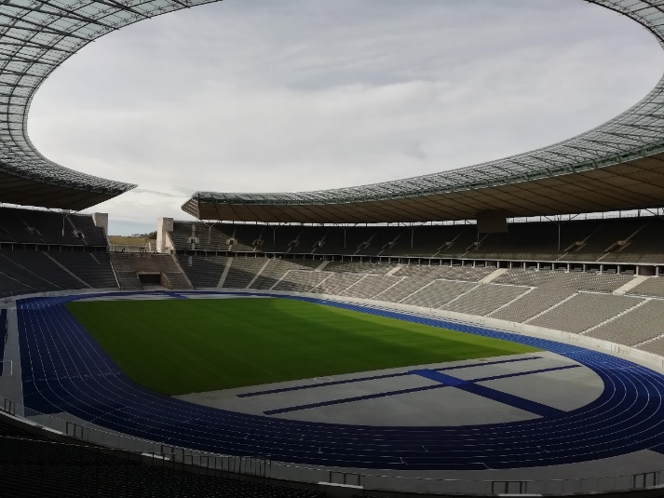
Trip opportunities

Slide 14
Trip opportunities

Slide 15
GCSE GERMAN
Einfach das Beste!
Danke schön!

