Slide 1
Composition – making your own music 30%
Composition 1: Completely Free choice in any style
Composition 2:Respond to a brief set by the exam board
2 compositions

Slide 2
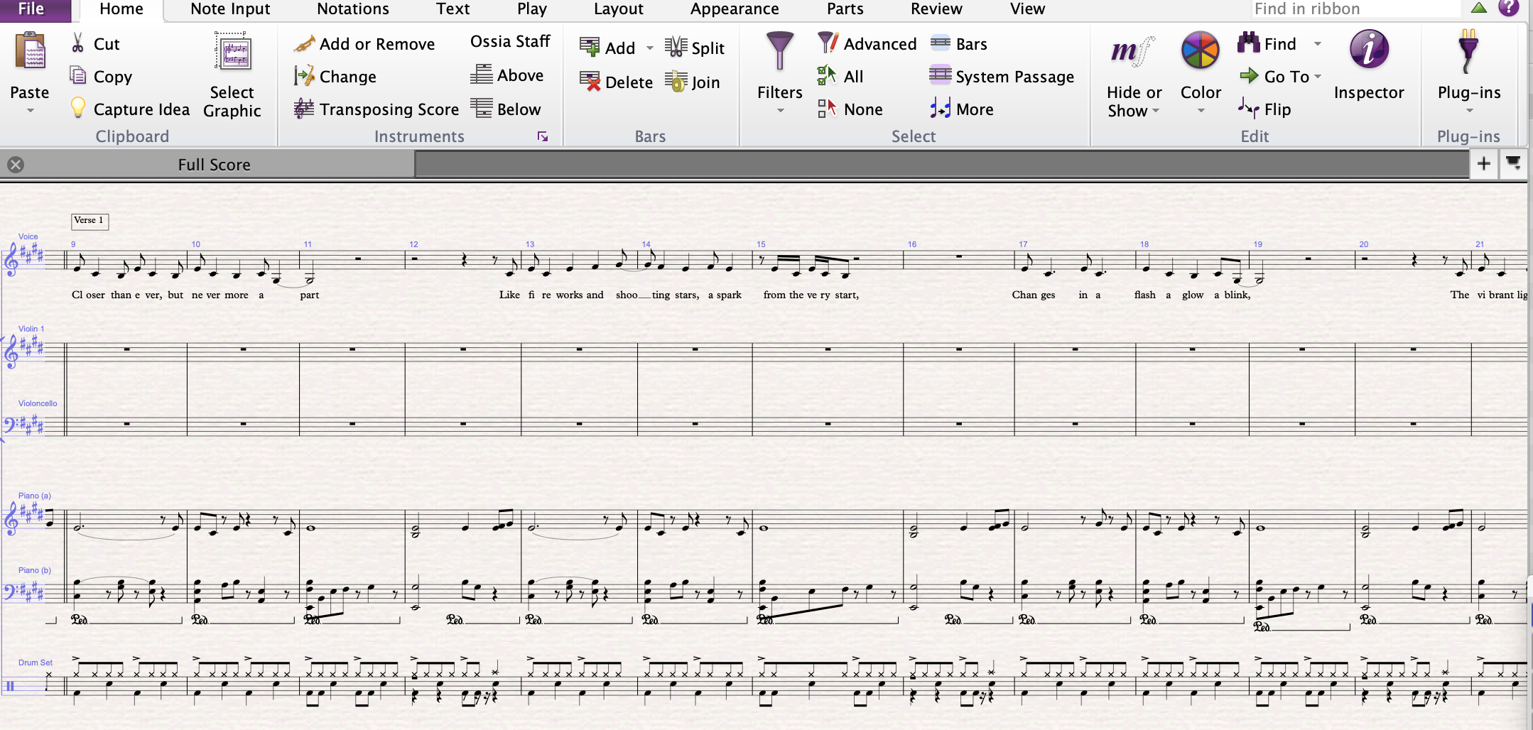
Composition: Making a Score
Sibelius software
You will need to learn how to write music down, which is why we start learning music theory (treble clef, rhythms etc) in Year 9 and then we build on this at GCSE; learning how to write for different instruments.
Notes:
You need to create a musical score, which is your music written down. We use a piece of software called Sibelius to do this.

Slide 3
Composition: Recording your music
You need to make a recording of your music. Listen to the example, the student recorded herself playing guitar, then overdubbed herself singing and finally, she used Sibelius software to play all the other instrument parts.
Notes:
You need to send of a recording of your music. Listen to the example below, the student recorded herself playing guitar, then overdubbed her singing, but she used Sibelius software so the computer played the other parts.

Slide 4
Examples of composition: Brief 1 Compose a piece to show a conflict between two gangs
Notes:
You need to send of a recording of your music. Listen to the example below, the student recorded herself playing guitar, then overdubbed her singing, but she used Sibelius software so the computer played the other parts.

Slide 5
Listening & appraising Exam 40%
Set works
Area of study 1 – Instrumental Music 1700 - 1820
J.S.Bach: 3rd Movement from Brandenburg Concerto no. 5 in D major
L.Van Beethoven: 1st Movement from Piano Sonata no.8 in C minor ‘Pathetique’
Area of study 2 – Vocal Music
H. Purcell: Music for a while
Queen: Killer Queen (from the album ‘Sheer heart Attack)
Area of study 3 – Music for Stage and Screen
S. Schwartz: Defying Gravity (from the album of the cast recording of Wicked)
J. Williams: Main title/rebel blockade runner (from the soundtrack to Star Wars Episode IV: A New Hope)
Area of study 4 - Fusions
Afro Celt Sound System: Release (from the album ‘Volume 2: Release)
Esperanza Spalding: Samba Em Preludio (from the album ‘Esperanza)
Notes:
Landmark pieces from 1700 to present day. Analyze each set work, then listen to music that is related to it.

Slide 6
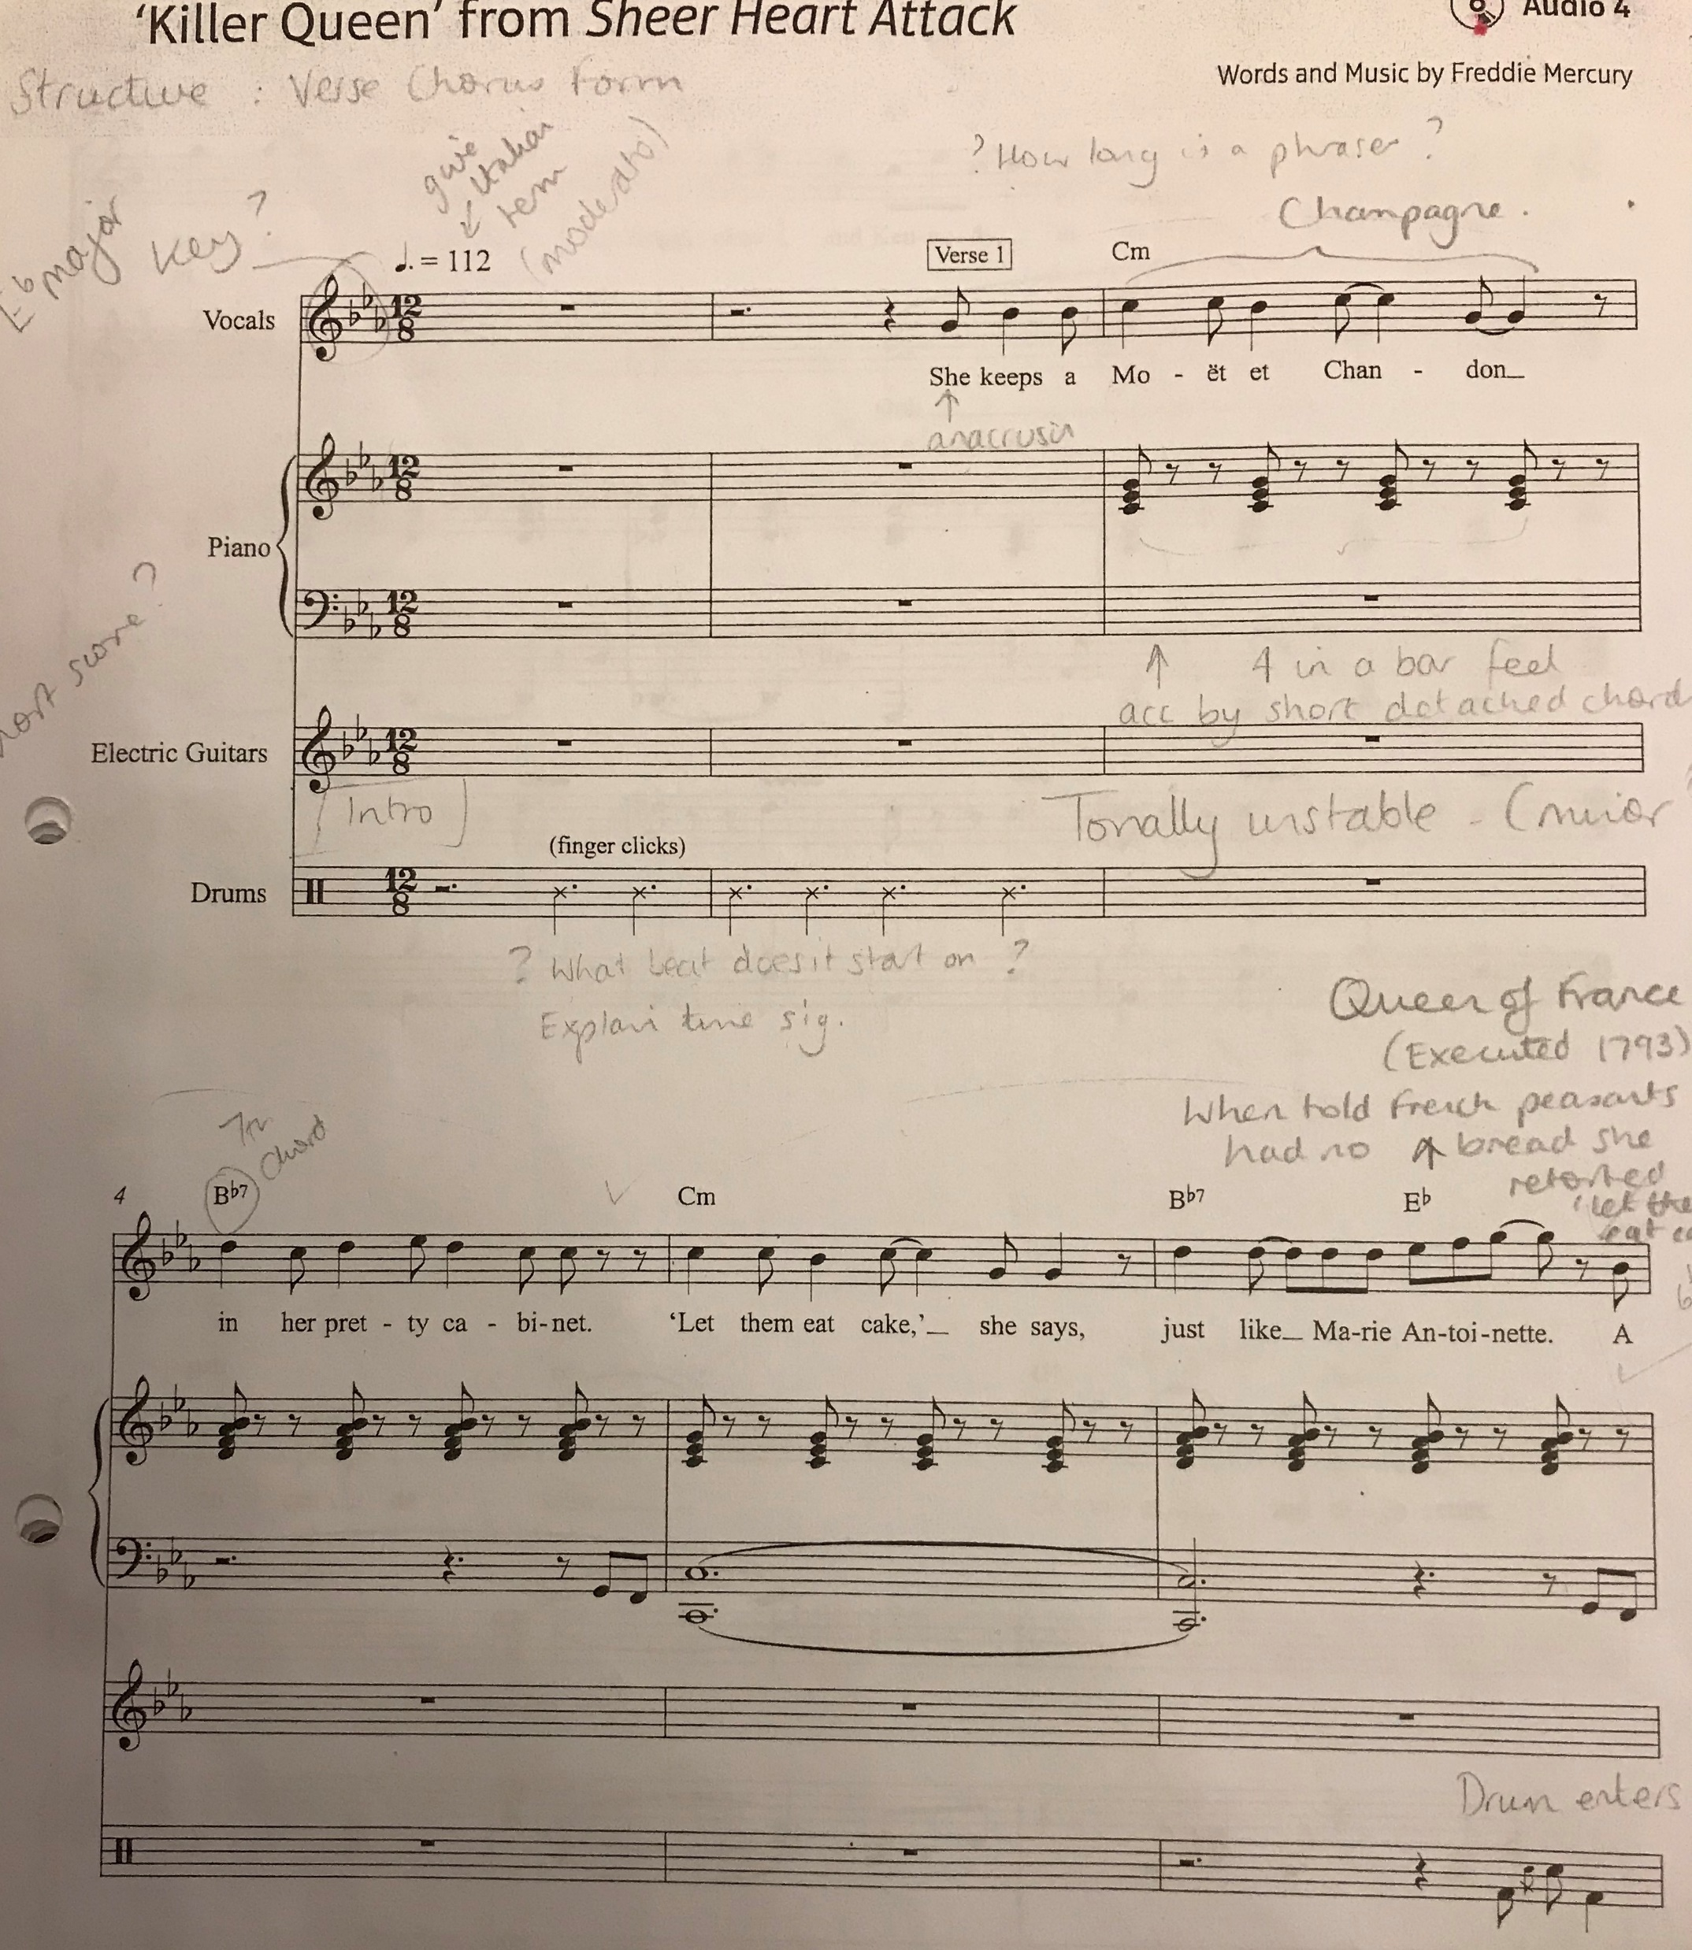
Exam work – musical analysis
You get:
8 mp3’s of the set works
8 scores of the set works
We learn music theory and vocab to describe the music we hear
Then we annotate our scores and answer questions about the music.

Slide 7
Here’s a real exam question.

Slide 8
Listening exam paper – see what other types of things we have to be able to answer

Slide 9
Different to Year 9?
1:1 personalised support
Recording studio work
GCSE Club
1 computer each!
Music Room 2
Studying new music
Small groups
Notes:
Learning an instrument/having singing lessons

Slide 10
What else can I expect?
Concert/recital opportunities
Workshops with Halle/Phil musicians
Concerts at RNCM & Bridgewater Hall
County level courses
Exposure at a regional & national level:
BBC Young composer of the year
Concerto competition
National Youth music festival

Slide 11
What can I do before Year 10 starts?
Learn how to use Sibelius software and compose a piece for an ensemble!
Get familiar with sequencing software and make a piece using multitrack recording.
Play your instrument lots and practise!!!
Listen to as many different types of music as possible.

Slide 12
So, why are you choosing GCSE music again?
Because of the crazy teachers?
Because we get the excellent
results for GCSE music?
Or simply because you’re brilliant musicians
and you love MUSIC!!!
Notes:
Could you do without Music on your timetable next year?!!!

