Slide 1
Why take GCSE Music?

Slide 2
Why take Music?
To build on your talent and develop your skills from Year 9
You enjoy performing
You enjoy composing
To give BREADTH to your options
You enjoy listening to music
You enjoy using computers
Because it will be useful to your career path
GCSE music is a creative subject which is both fun and challenging!
Great results:
100% pupils gained 9 – 6
2020
Notes:
You might already be thinking ahead to a career in Music, Musical theatre, Acting, Media, Dance or Arts but if listening to music, playing it and creating it is important to you, then that’s a good enough reason to be thinking about GCSE Music.

Slide 3
GCSE Music - Edexcel
Performing
30%
Composing
30%
Listening & appraising
40%
‘

Slide 4
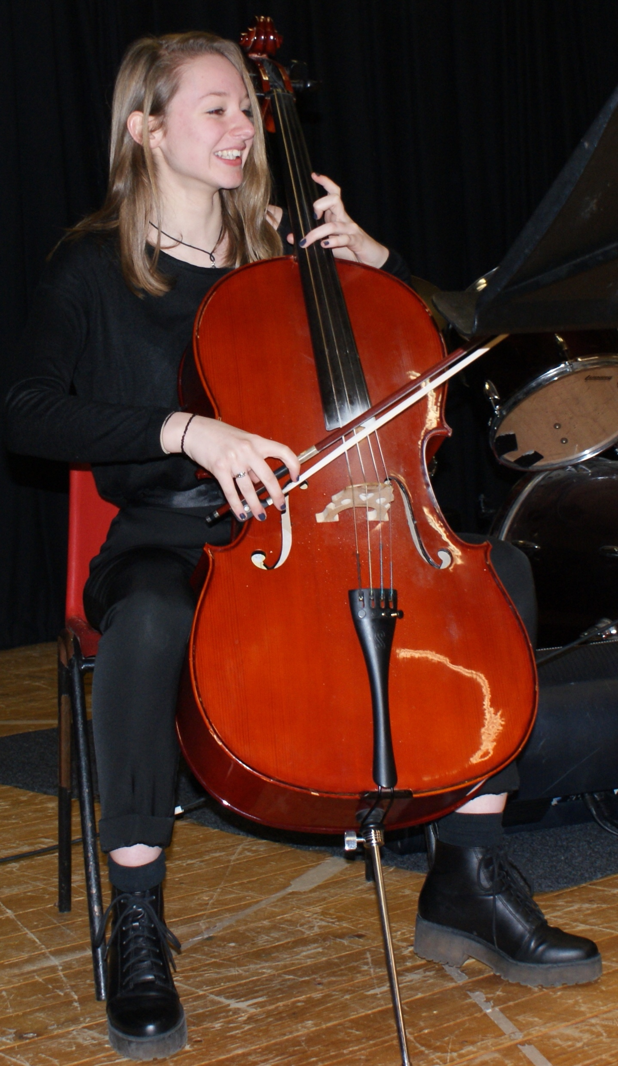
How is the course split up?
Paper 1 Performing: one solo
one ensemble
= 4 mins minimum (30%)
Paper 2 Composing: one free choice
one in response to a brief
= 3 mins minimum (30%)
Paper 3 Written/Listening exam: based on 8 set work
= 1hr 45 (40%)
Notes:
Let’s look at each of these in a bit more detail

Slide 5
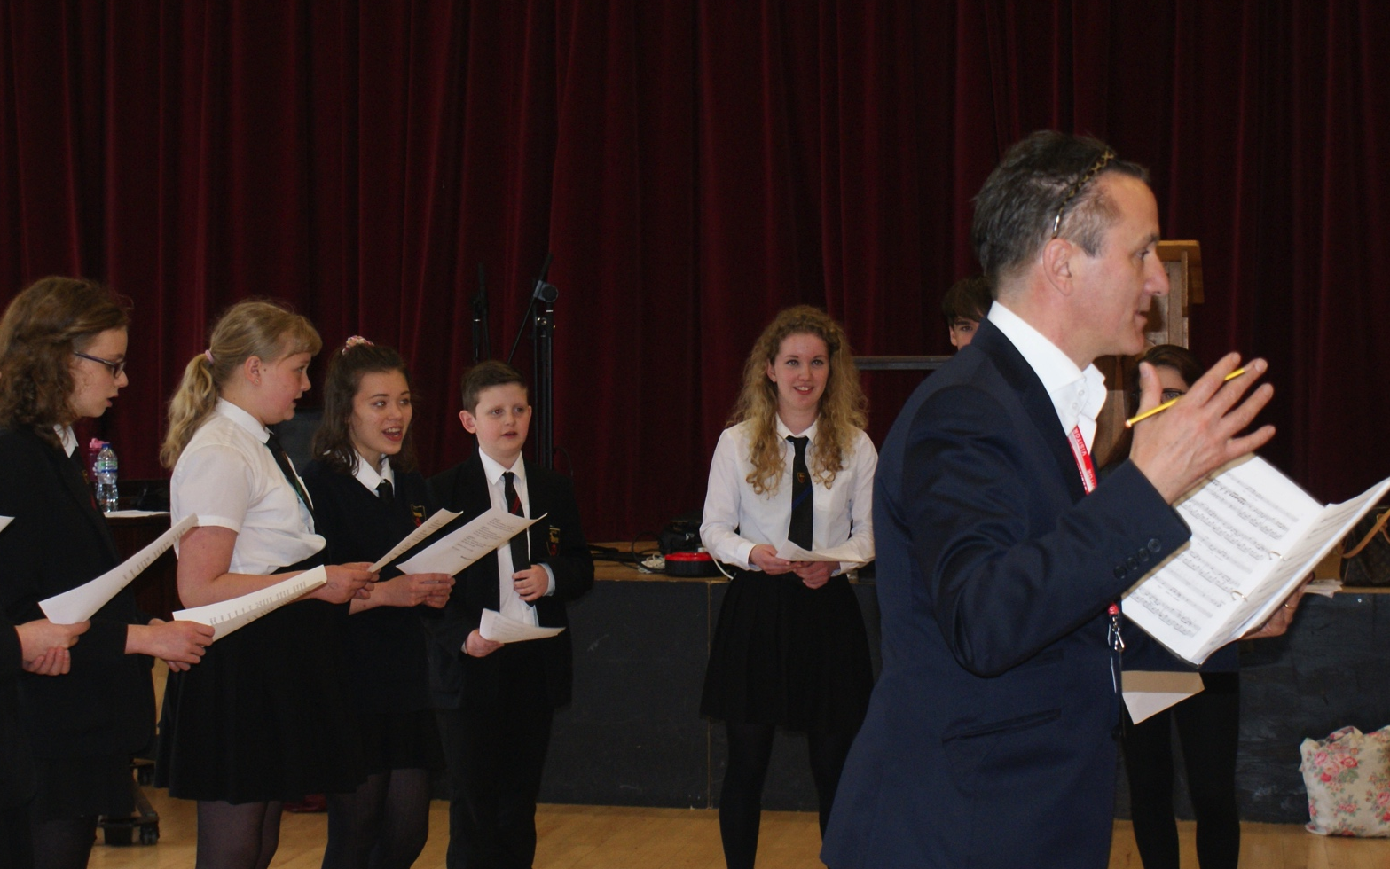
Performing 30%
Masterclass with musicians at Buxton Festival
‘We get so much variety of performance work at GCSE; working on a whole class piece or in response to a topic as a soloist. There are GCSE recitals and concerts, and lots of opportunities to perform beyond our school.’ - Year 11 Yasmin
Performance coursework = 30%
Solo
Ensemble
‘
Composing coursework = 30%
Are you learning a musical instrument or, do you love singing?
Notes:
Advice about learning an instrument, criteria, LOD and example of ens perf

Slide 6
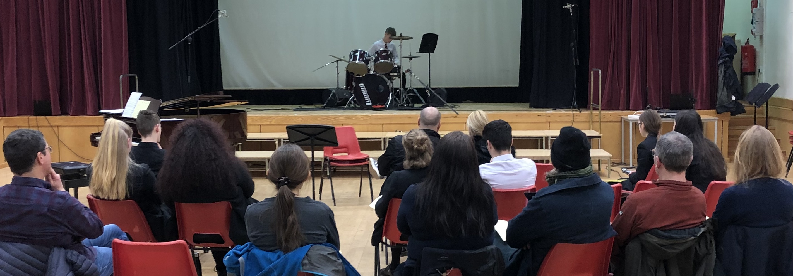
Solo Work
Performance coursework = 30%
Criteria 1 Accuracy & fluency
Criteria 2 Interpretation
Criteria 3 Technique
‘
Composing coursework = 30%
Are you learning a musical instrument or, do you love singing?
Notes:
This is a GCSE recital; the opportunity to showcase your work to a specially invited audience. Up front and personal! Recorded so that you can listen back and learn from how you performed.

Slide 7
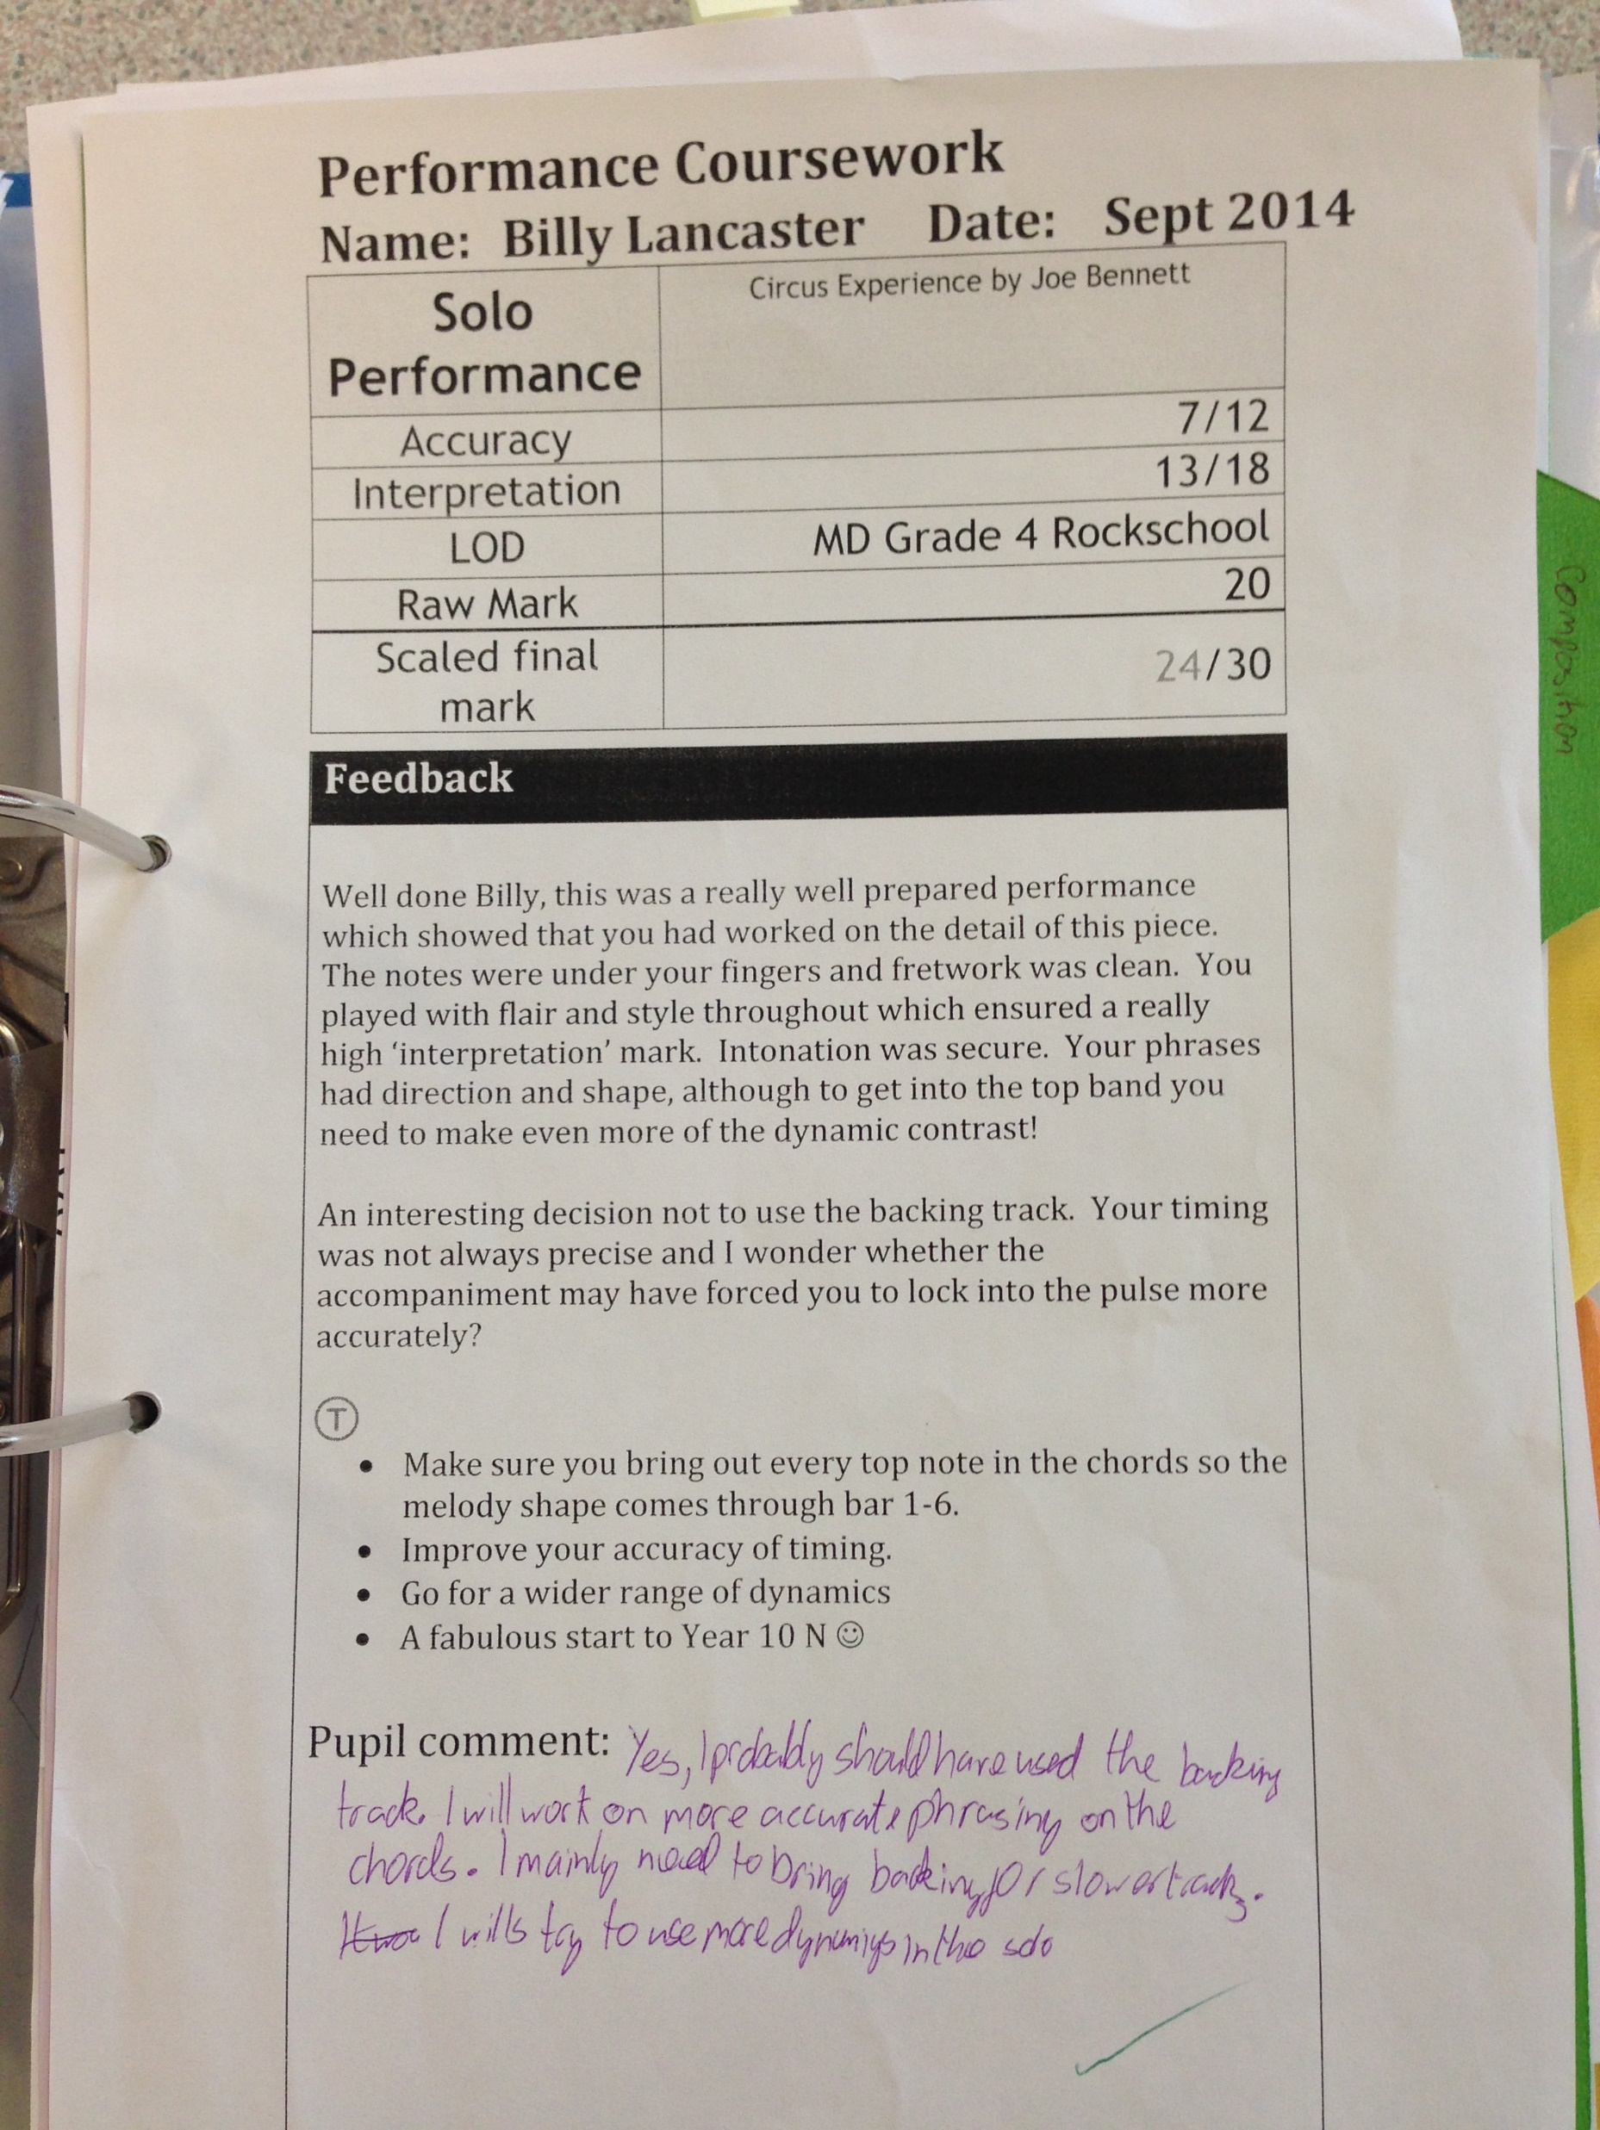
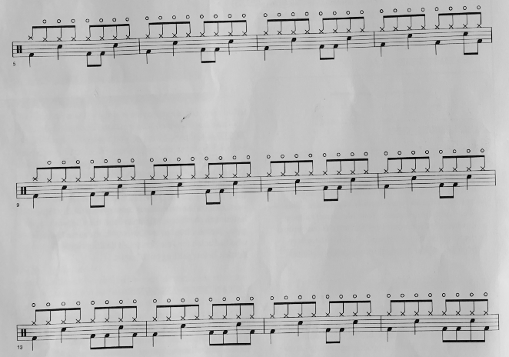
Regular feedback
LOD: How hard is it?
Performance coursework = 30%
3 levels of difficulty:
Easy Grade 0-3
Standard Grade 4
More difficult Grade 5-8
‘
Composing coursework = 30%
Notes:
Advice about learning an instrument, criteria, LOD and example of ens perf

