Slide 1
Y11 Welcome Evening

Slide 2
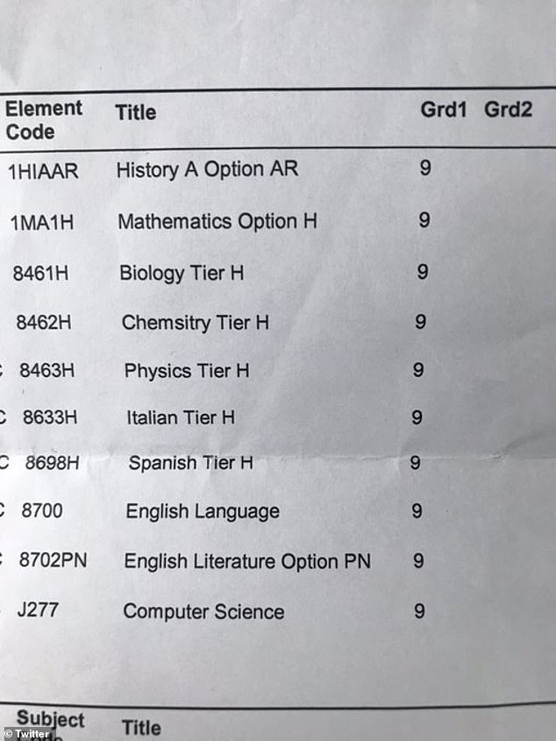

Slide 3
Key Dates
Tuesday 15th September – Y11 Welcome Evening
Monday 2nd November– Mocks 1 begin
Tuesday 7th January – Y11 Revision Support Evening
Thursday 14th January– Y11 Parents Evening
Friday 29nd January - Mocks 2 begin
Monday 15th March – Targeted parents evening
Thursday 10th May - Summer '25 Exam Series begins

Slide 4
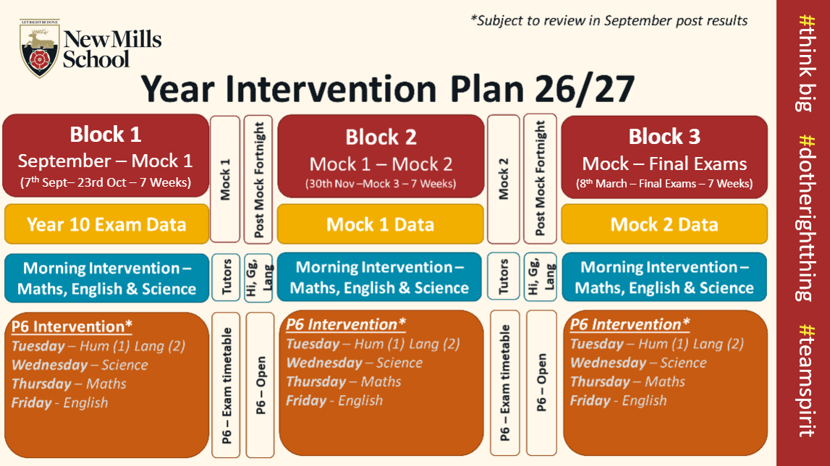

Slide 5
Intervention

Slide 6
Intervention
What is it?
When is it?
Is it useful?

Slide 7
Period 6 Intervention
Week 1
Tuesday | Wednesday | Thursday | Friday
Geography History | Science | Maths | English
Week 2
Tuesday | Wednesday | Thursday | Friday
Languages | Science | Maths | English

Slide 8
Attendance

Slide 9
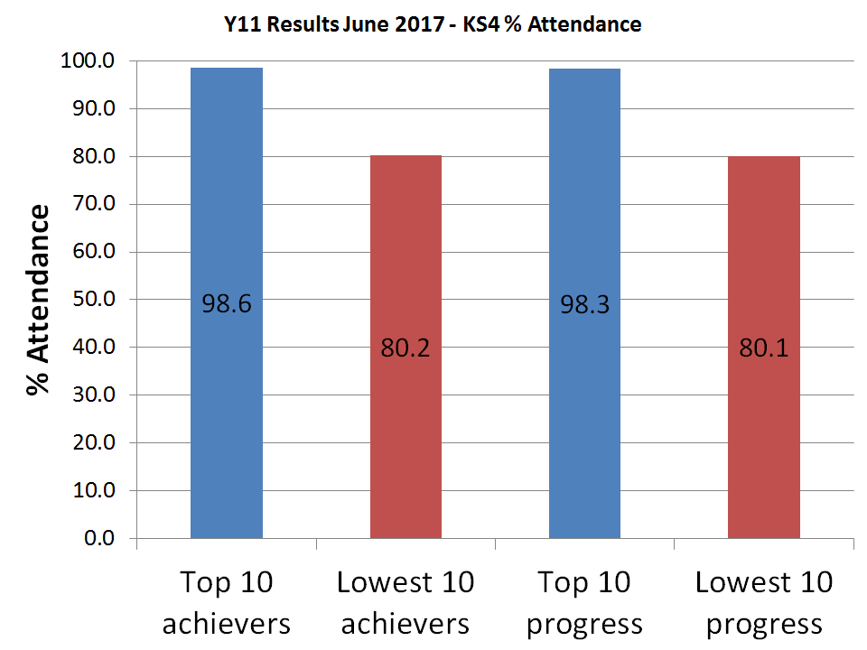

Slide 10
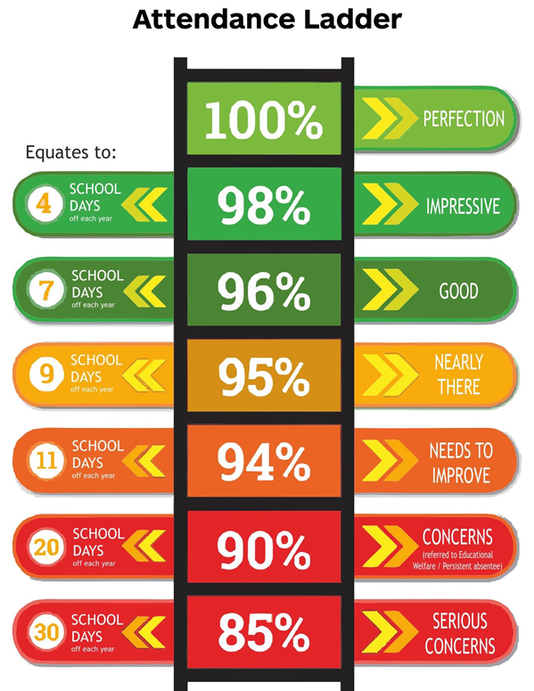

Slide 11
Additional Attendance Information
No authorised holidays this year
Fixed penalty notices issued for 10 unauthorised absences each term
Provisional date of the last GCSE exam (23rd June)
  Please don’t book holidays before this date
Reoccurring illnesses/concerns procedures
Support available on request - please get in touch
Please keep your contact information up to date

Slide 12
How Parents can Support Students at Home
Encourage attendance
Encourage further work
Be inquisitive

Slide 13
English

Slide 14
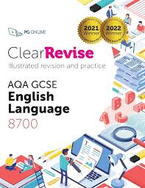
What Students are Currently Studying in English

Slide 15
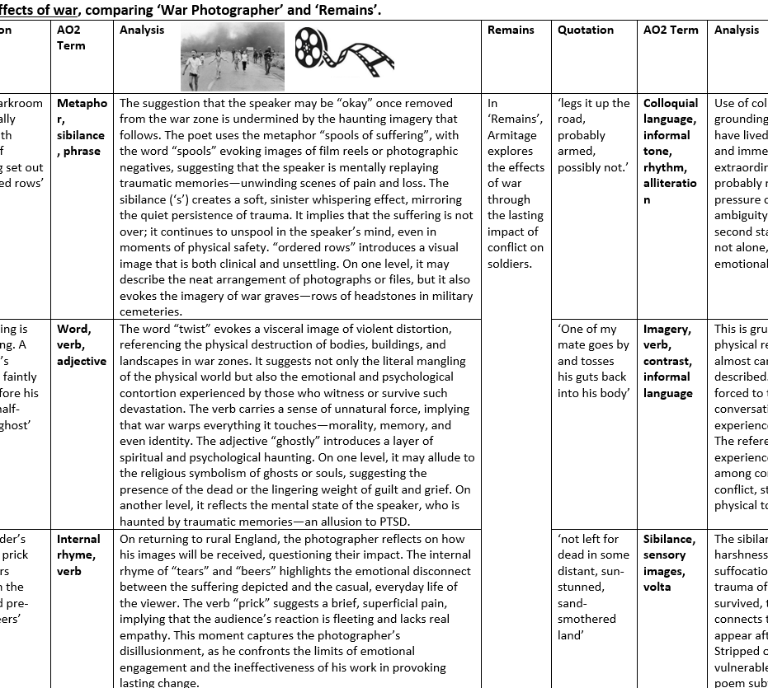
How Parents can Support Students at Home in English
Ask about the topics we are studying in lessons.
Talk to the students about the fortnightly revision topic. Help them learn key quotations and analysis.
Help by quizzing the students about the themes and characters. Use online resources to help with this.
Encourage students to re-read the texts or listen to audio-book version.
Stick key quotations on the fridge.
Help them to organise the notes that they bring home.

Slide 16
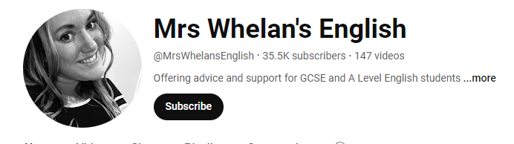

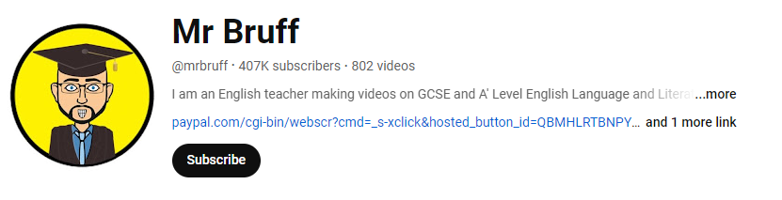
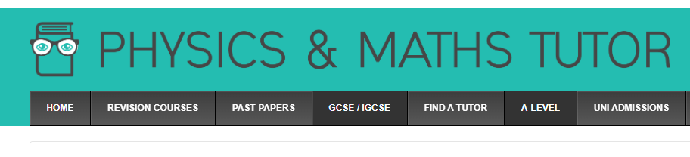
Helpful Resources for Supporting Students in English
Mrs Whelan's English – YouTube
Mr Bruff – YouTube
English Revision - PMT (physicsandmathstutor.com)
Teaching English | Just another WordPress.com site

Slide 17
Maths

Slide 18
What Students are Currently Studying in Maths
Simultaneus equations
Ratio & Proportion
Area & Volume
Similarity & Congruence
Sequences & Proof
Standard Form
Work with Circle
Set Notation & Venn diagrams
Vectors (H only)
Functions & Graphs
Equations & Formulae
Rates
Angles, Bearings & Trigonometry
Construction & Loci
Transformations
Exam dates
P1 (non-calculator)
14 May 2027
P2 (calculator)
27 May 2027
P3 (calculator)
14 June 2027

Slide 19
How Parents can Support Students at Home in Maths
Case 1 A parent says: "I was never good at Maths, so my child probably won't be good at Maths either."
Case 2 A student works hard and keeps practising until she get the correct answer.
Case 3 A student says: "I can do it in my head, so I'll just write down the answer. It saves me time."
Encourage a positive attitude towards maths
Help your child view Maths as a skill that improves with practice, rather than as something they are naturally “good” or bad” at.
Understanding that making mistakes is part of learning
Check all equipment is available and ready.
Check they have a calculator. Casio Fx-85GTCW (parents pay)
Set a study routine but allow breaks to prevent burnout.
Use online resources and tools

Slide 20


Helpful Resources for Supporting Students in Maths
SPARX – Homework, independent learning
Maths Genie
CGP Revision book, The Crossover Book (parents pay)
OnMaths
Studymaths.co.uk
Corbettmaths
Drfrostmaths
www.mrmorleymaths.co.uk

Slide 21
Science

Slide 22
What Students are Currently Studying in Science
All students, both triple and combined students are currently studying the content in paper 2.
More details on the individual topics can be found on the science long term plan on the school website.

Slide 23
How Parents can Support Students at Home in Science
Homework on Sparx Science is set weekly on a Thursday and due in the following Wednesday.
Revision of the topics in paper 1 ready for the mock exams. Topic lists are on Class Charts.

Slide 24

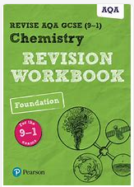
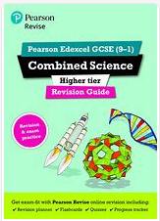
Helpful Resources for Supporting Students in Science
Sparx Science
Kerboodle
BBC bitesize – AQA trilogy or separate science
Revision guides and workbooks on parent pay.

Slide 25
MFL

Slide 26
Spanish: What students are doing now.
HT1: Mi barrio y yo (My neighbourhood and I) – describing where we live now, how it has changed and where we would like to live, and describing shopping preferences.
Preparing for mock exams, particularly the speaking exam, by learning and practising their general conversation questions.
HT2: El mundo mejor para todos (A better world for all) - talking about how to help ijn your community, climate change, actions to help the environment, and solutions.

Slide 27
What can I do to support my child right now?
Ensure that your child is regularly learning their vocabulary using Quizlet and/or the look/cover/write/check method. Students are given new vocabulary to learn and are tested every week.
Practise their General Conversation questions with them. Students should know which questions they need to practise for the mock speaking exams on w/c 12 October.
Encourage them to attend interventions on Tuesday Weeks 1 and 2.
Encourage them to use activehub.pearson.com for revision, their teacher will set tasks for them to complete.
Encourage them to expose themselves to target language media (films, TV, music, YouTube).

Slide 28
Useful resources:
www.activehub.pearson.com
End of chapter tests in Pearson Edexcel Spanish GCSE textbooks
CGP Revision and Practice workbook
CGP Exam Practice workbook
CGP Translation skills workbook
BBC Bitesize
Quizlet
Easy Spanish
Past reading and listening papers have some use although the spec has changed.
As this is the second year of a new specification, please ensure all revision resources are for the 2026 Pearson Edexcel exam!

Slide 29
Humanities

Slide 30
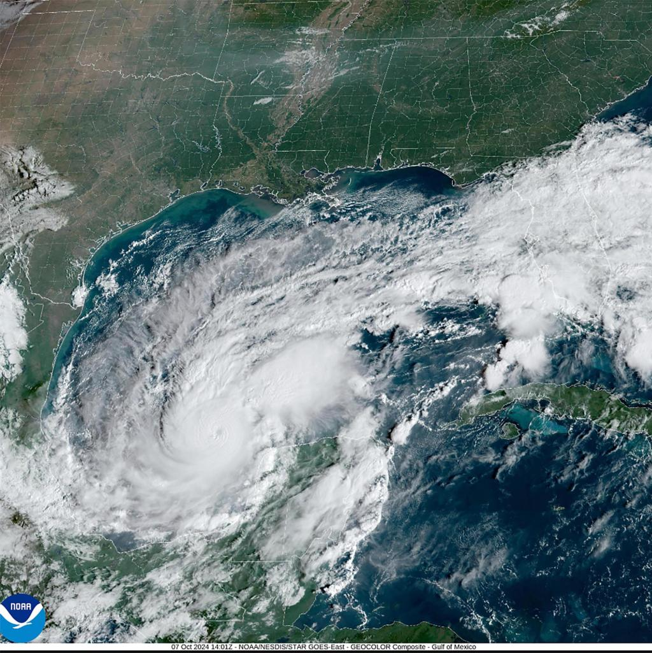

What Students are Currently Studying in GEOGRAPHY
This Half Term: Global Hazards
Tectonic hazards – volcanoes and earthquakes
Global Atmospheric Circulation System
Comparison of extreme weather in Australia and the UK
Tropical storms
Hurricane Katrina
Drought
El Niño and La Niña
UK drought 2012
Next Half Term: Sustaining Ecosystems
Ecosystems, food chains, food pyramids and the nutrient cycle
Biomes
Tropical rainforest: characteristics, value to humans and how humans affect the rainforest
Sustainable management of Costa Rica’s tropical rainforest
Polar environments: Characteristics, how humans affect the Arctic
How the Icehotel is an example of sustainable management in the Arctic
How different countries are sustainably managing Antarctica through the Antarctic Treaty

Slide 31
How Parents can Support Students at Home in GEOGRAPHY
Ensure your child has signed up to Seneca so they can access revision homeworks
Test your child on the case studies for the next 2 half terms using the case study bibles they have been given
Test your child on the key knowledge from the knowledge organisers
Encourage your child to answer an exam question from the case study bible so they can practise answering exam question
Encourage your child to watch YouTube videos from the Met Office that explain weather processes and events
Test your child on the topics they are studying using revision guides: CGP and Hodder are the most suitable. CGP have also created a set of flashcards

Slide 32

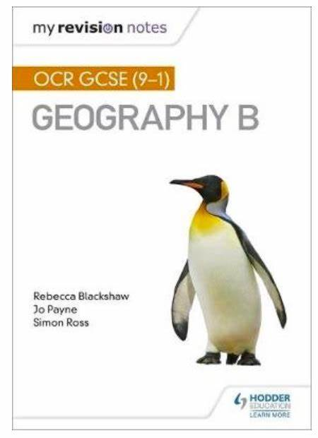

Helpful Resources for Supporting Students in GEOGRAPHY
Case study bibles and knowledge organisers (Your child should have a copy of these)
Seneca
Revision challenge sheet
Met Office channel on YouTube
Revision guides
BBC Bitesize (OCR Geography B)

Slide 33


What Students are Currently Studying in History
Currently…
Our next topic…
After this content Year 11 will be moving on to The Elizabethans. Students focus on source and interpretation analysis, as well as continuing their evaluative and explanative skills in relations to historical arguments regarding the Elizabethan era.
Learners in History are currently studying Living Under Nazi Rule. This will continue on until roughly December/January. This topic will be tested in the November PPE ,alongside Y10 topics "The Making of America" and "Quarry Bank Mill"​
​

Slide 34
How Parents can Support Students at Home in History
· Ensure your child has signed up to Seneca so they can access revision homework
· Test your child on content from Year 10 (The People’s Health, Making of America, Quarry Bank Mill) as well as Year 11 topics – this can be in the form of short quizzes or ensuring they are making revision content
· Encourage your child to answer an exam question from textbooks/teachers so they can practise answering exam questions
· Encourage your child to watch GCSE History OCR B YouTube videos from the “Helpful Resources” sections, these will break down content
· Test your child on the topics they are studying using revision guides: CGP and Hodder are the most suitable.
· Encourage your child to engage with their revision calendar—this will be a series of revision tasks, including essay questions, from the start of September until the GCSEs

Slide 35

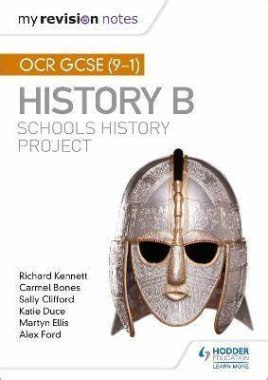

Helpful Resources for Supporting Students in History
Revision calendars (published on classcharts)
Seneca
Revision guides
BBC Bitesize (OCR History B)
Relevant YouTube Channels:
  Pete Jackson
  Dormston History

Slide 36
‘Open’ Subjects

Slide 37
What Students are Currently Studying in Open Subjects
Art, Performing Arts, Media, Sport Science, Engineering, Health and Social Care, Food and Cooking, Construction
'Open' Subjects are likely to contain:
  A large controlled assessment element
  Plenty of practical work
  A focus on skills and problem solving
  Essential extra-curricular elements (such as being a member of a sport team)
Substantial controlled assessment elements.
  Large projects that have written, design and practical components.
  Very stimulating and frequently high-grading

Slide 38
How Parents can Support Students at Home in Open Subjects
Subject | Controlled Assessment | Examined Element
Art | 60% | 40%
Drama | 60% | 40%
Engineering | 60% | 40%
Media Studies | 60% | 40%
Sport Science | 60% | 40%
Health and Social Care | 60% | 40%
Food and Cooking | 60% | 40%
Construction | 60% | 40%
Ensure students are meeting both mid project milestones and end of project deadlines during controlled assessment
Support students with the practical elements that take place outside of the classroom
Encourage students to make use of any intervention available
Remind students they can access computers in Rm 17 to work during lunchtime

Slide 39
Helpful Resources for Supporting Students in Open Subjects
Subject specific links and resources can be found in the booklet
The BBC Bitesize website has plenty of resources for vocational qualifications (as well as GCSE)
There are many excellent content creators on YouTube who can introduce students to advanced techniques and new ideas

Slide 40
