Slide 1
Welcome to New Mills
Parent Forum

Slide 2
Objectives for this evening
To know and understand the changes to the way secondary schools are now measured
To share our exam results and what this means for us
To know the changes to the exam structure and how this will affect your child
To know our main priorities for this year to continue to drive improvement

Slide 3
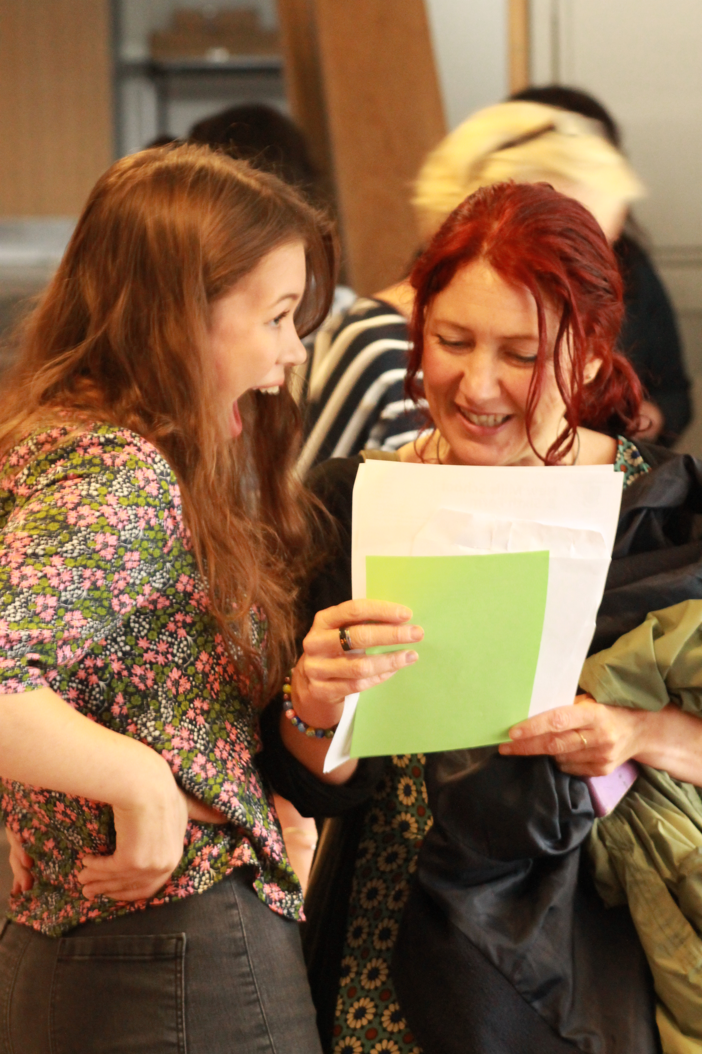
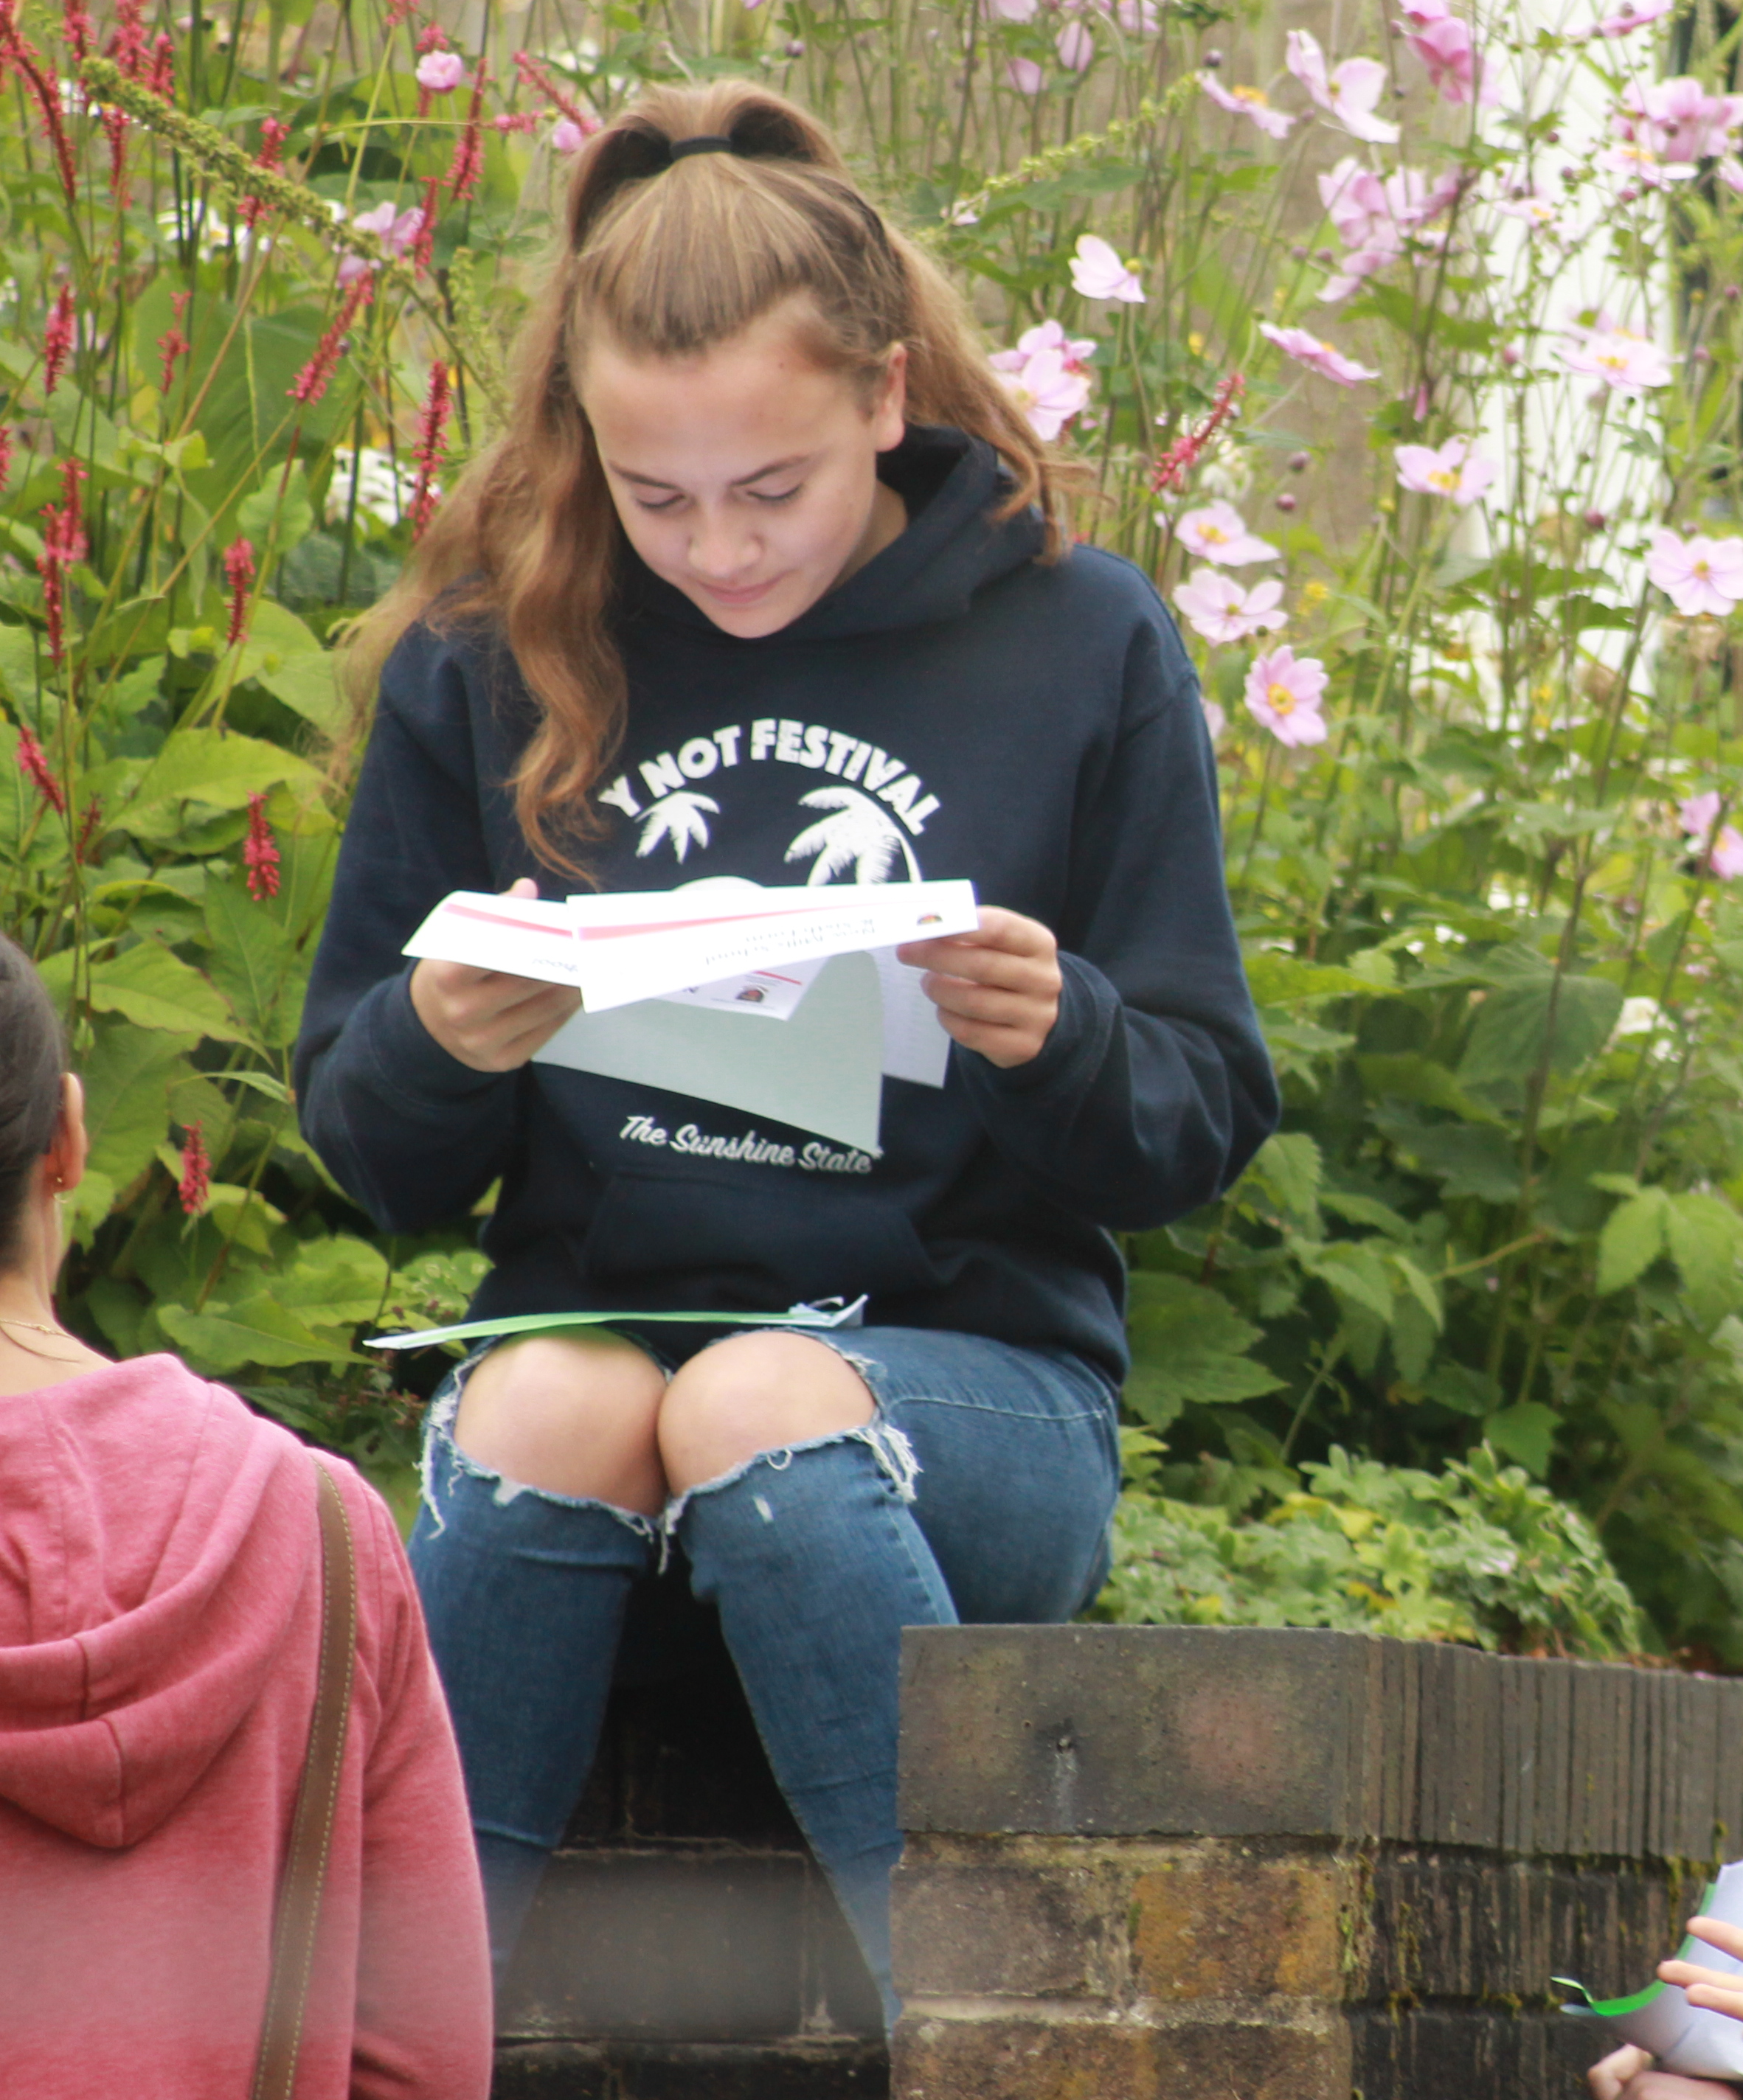
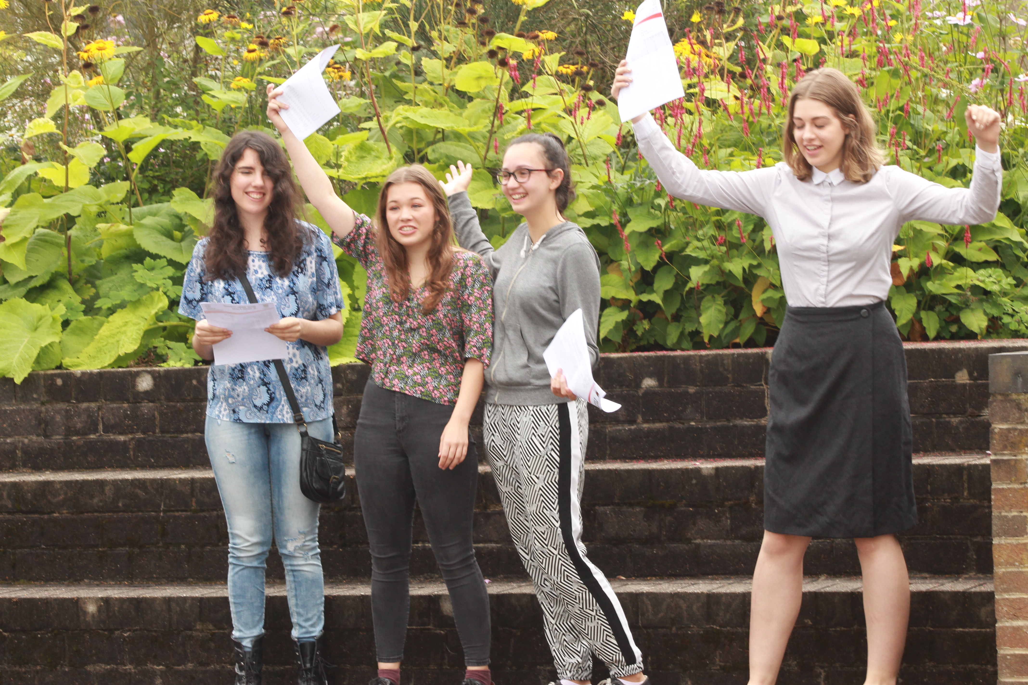
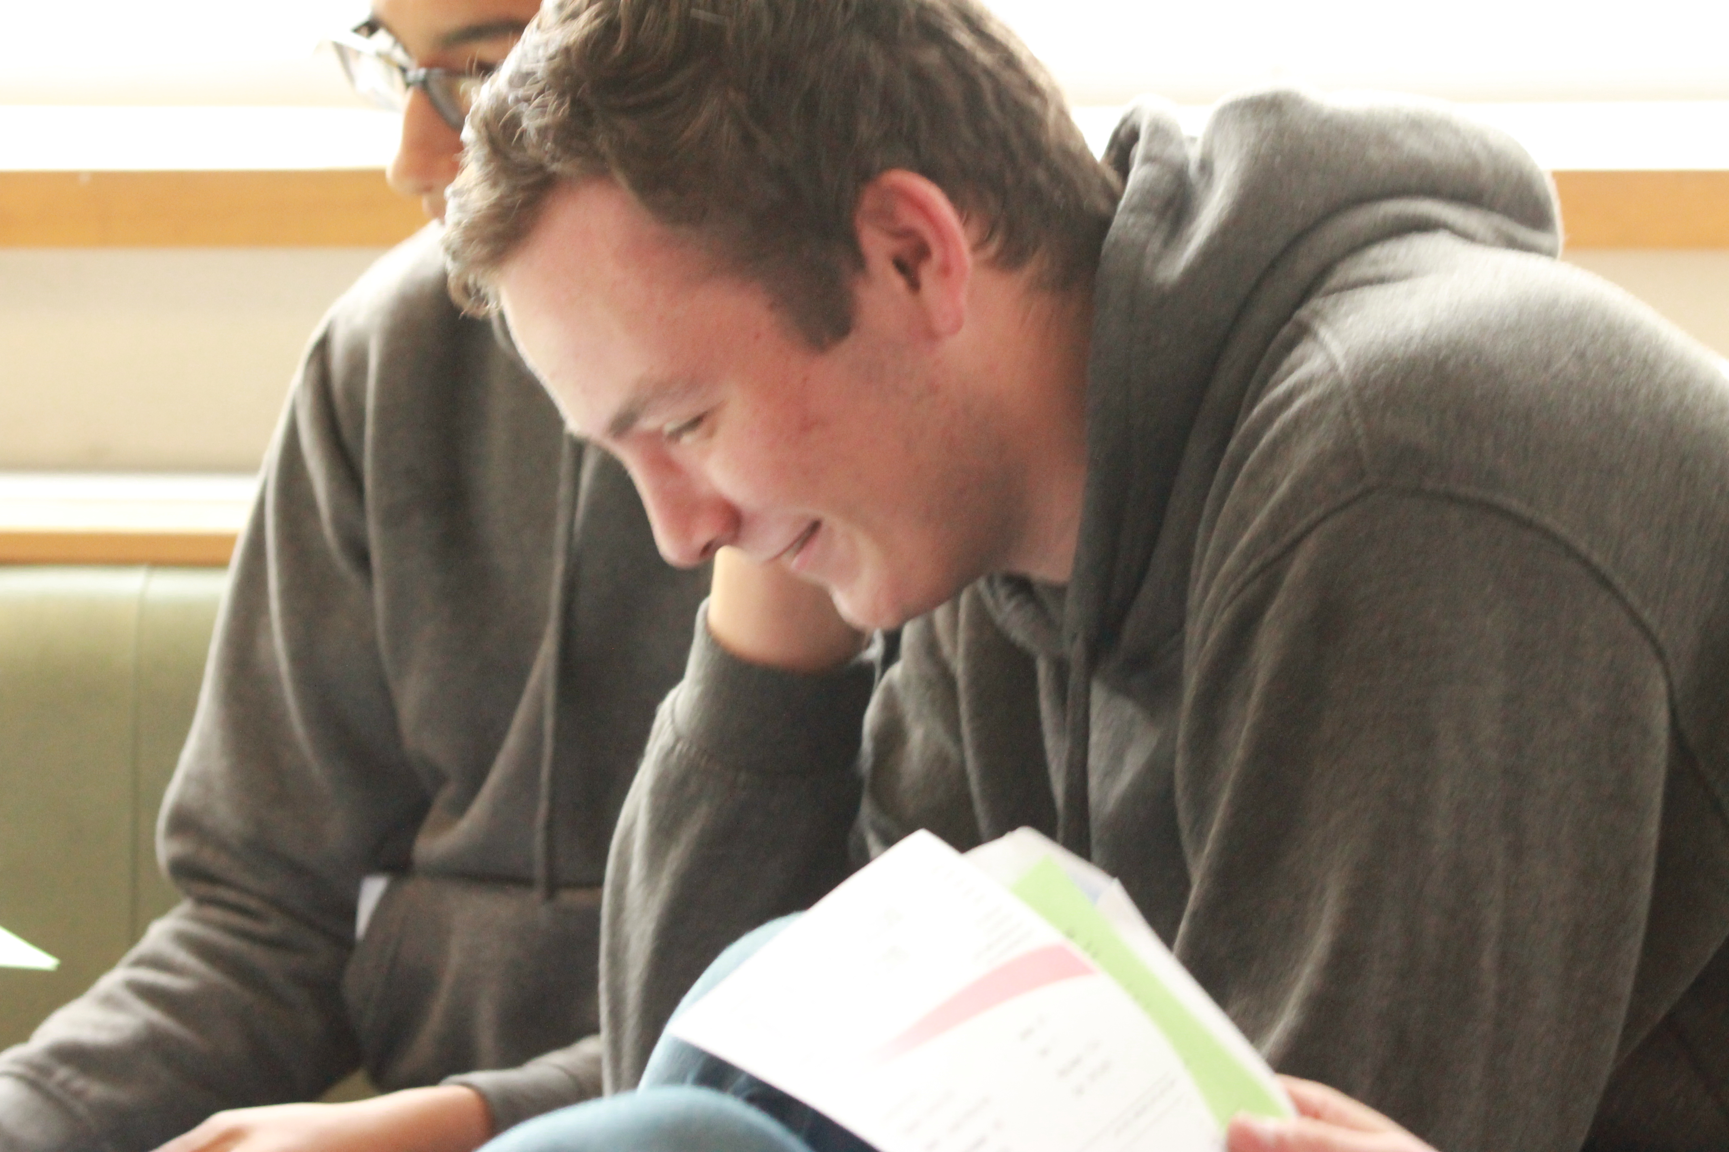
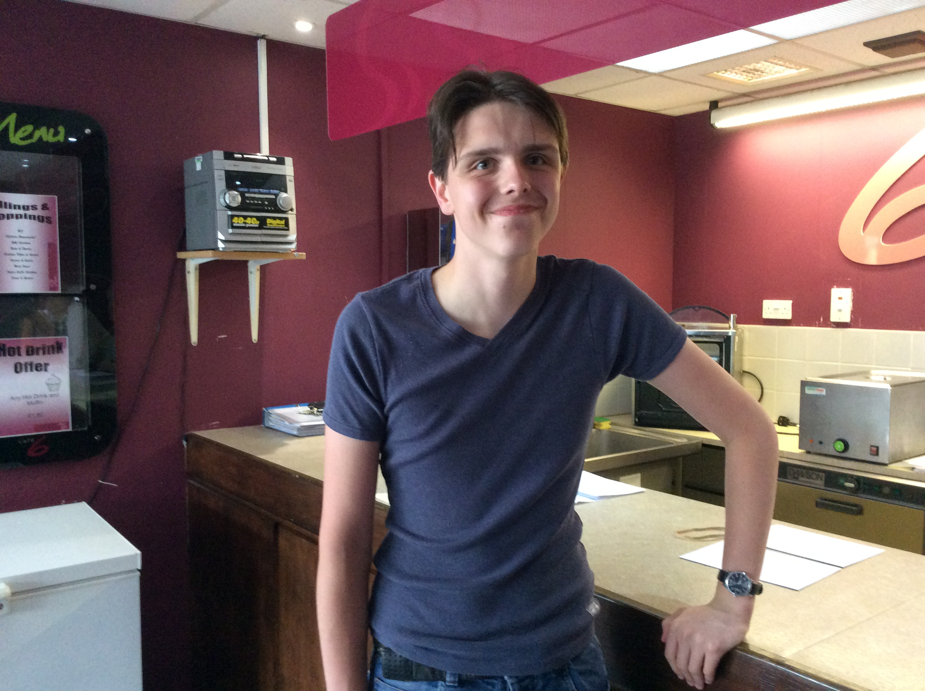
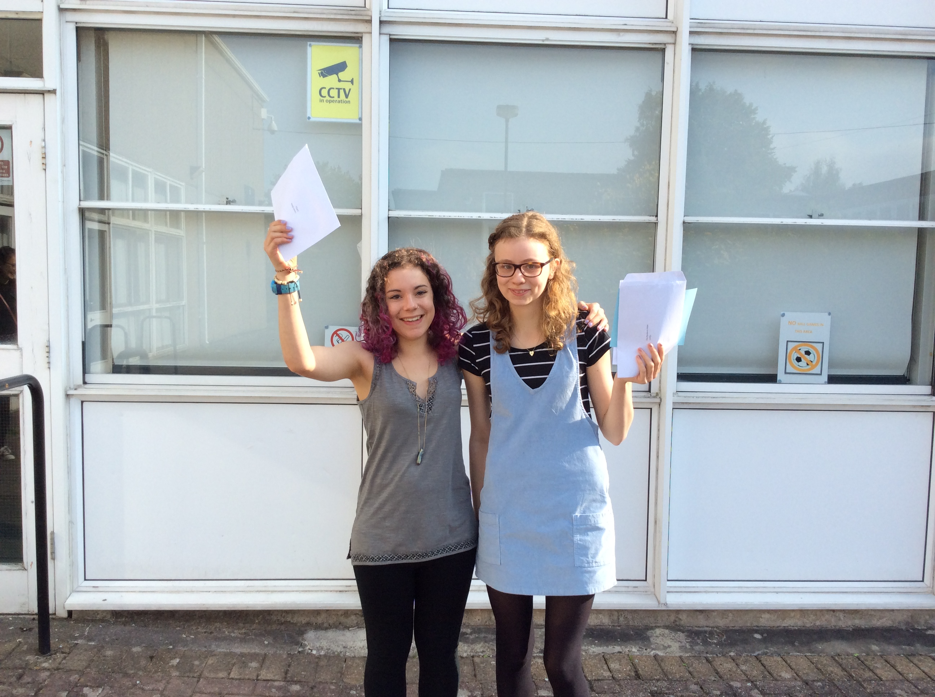
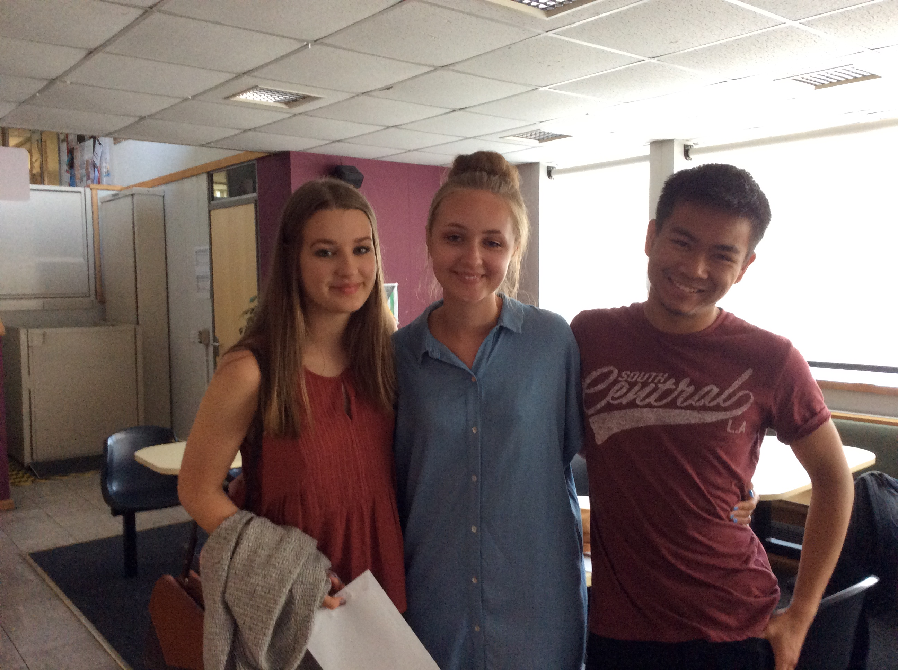
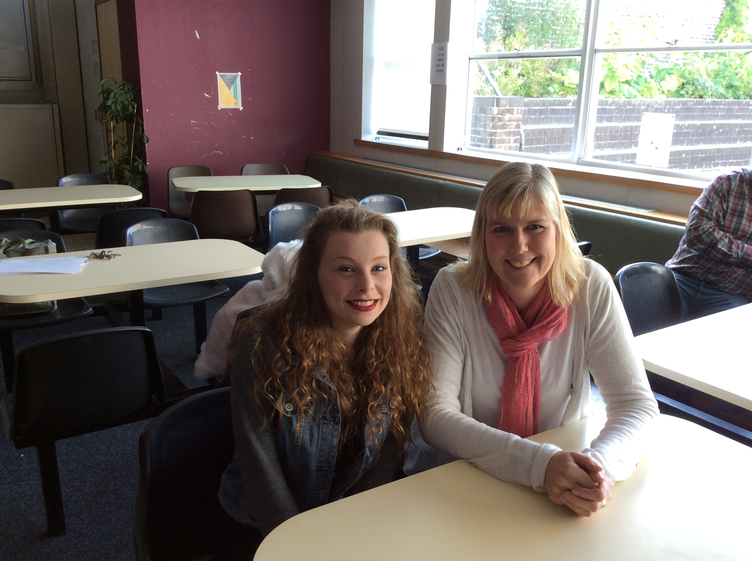
Results headlines

Slide 4
Key stage 4 measures
New key stage 4 measures encourage a broad and balanced curriculum with a strong emphasis on an academic core:
New focus on pupil progress – Progress 8 measures pupils’ progress in 8 qualifications. These are:
Attainment 8 measures pupils achievements in the same subjects
Percentage of pupils achieving a ‘good pass’ in English and maths
Percentage of pupils achieving the EBacc.
English
maths
Three of: science, computer science, history, geography and languages
Any three other approved qualifications
Notes:
From 2016, the Government is also reforming the way that school performance is measured to place more focus on the progress that pupils make.
Secondary school/GCSE performance
For secondary schools the Government is introducing a new measure called Progress 8. In the past the main measure of school performance was the percentage of pupils who got 5 or more A*-C grades at GCSE (including English and maths) – which may have encouraged too much focus on pupils just on the borderline of getting a C grade, at the expense of other pupils.
Progress 8 will measure how well schools have helped pupils of all abilities to perform across 8 qualifications (as outlined on the slide).
If for example the school’s Progress 8 score was 0.77 it would mean that on average pupils at that school achieved over three quarters of a grade better per subject than other pupils with the same prior attainment.
School scores should be interpreted alongside their associated confidence intervals. If the lower bound of the school’s confidence interval is greater than zero, it can be interpreted as meaning that the school has achieved greater than average progress compared to pupils nationally, and vice versa if the upper bound is negative. https://www.gov.uk/government/uploads/system/uploads/attachment_data/file/497937/Progress-8-school-performance-measure.pdf
EBacc entry is currently reported as an additional measure of school performance. In the consultation on implementing the EBacc, the government proposed that the percentage of pupils entering the EBacc should become a headline measure of secondary school performance.

Slide 5
Changes to the way secondary schools are now measured

Slide 10
GCSE Headlines
GCSE new measures | 2015 | 2016
Progress 8 | -0.11 | 0.09
Attainment 8 | 46.38 | 47.87
A*-C Eng & Maths | 54% | 53%
Ebacc | 15% | 17%
Notes:
Big 4 measures – our stats, talk through the story:
Sig -, so floor standard of 60% always a challenge
2. Difficult to compare as no national yet and not a figure we are used to, but has increased from last year
3. Below national but an increase, this year group had a free choice and were not directed to Ebacc or P8 options
4. 0 means all students make expected progress, 0.5 = outstanding, but health warning – LAST YEARS A8 FIGURES USED Amazing result if it remains

Slide 11
GCSE Headlines
GCSE old measures | 2014 | 2015 | 2016
5+A*-C (inc EM) | 53% | 54% | 51%
English 3LP | 64% | 74% | 85%
English 4LP | 27% | 24% | 53%
Maths 3LP | 65% | 61% | 60%
Maths 4LP | 13% | 19% | 28%
Notes:
Attainment: actual results
Progress: the value added that pupils have made from one key stage to the
next .

Slide 12
Results headlines
Attainment is slightly below where it should be but improvement in higher grades
13/23 subjects in line with or above National Average
% 3xA*/A grades increased by 13%
% 5xA*/A grades increased by 11%
Progress is very good overall with many subjects improving 3LP and 4LP
3LP English increased by 11%
4LP English increased by 29%
4LP Maths increased by 10%
13/23 subjects have improved their 3LP outcomes
17/23 subjects have improved their 4LP outcomes
Notes:
ICT gone from 6.5 to 54%
Chemistry from22 to 55
Physics 30 to 53
Biology 22 to 69
History 17 to 46

Slide 13
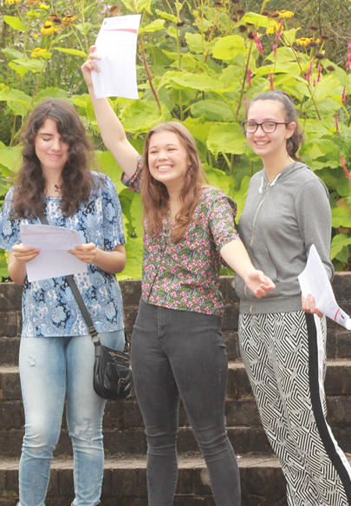
Students’ Attainment
Mia Rothwell | 4A*, 5A, 1B
Rose Bartels | 4A*, 3A, 2B, 1C
Isobel Harwood | 4A*, 1A, 3B, 2C
Carys Nunn | 4A*, 4A, 1B, 1C
Kier Chetham, | 3A*, 5A, 1B
Austin Theis-Pickford | 3A*, 3A, 1B, 1C
William Lancaster | 2A*, 6A, 1B, 1C

Slide 14
Students’ Progress
Qualification Name | Grade | Targets Grade
Additional Science | B | D
Drama | C | D
English Language | A | C
English Literature | A | C
French | B | D
Geography | B | D
Mathematics | B | D
Media Studies | D* | P
Religious Education (SC) | D | D
Science | C | D
Notes:
21 students above 1 for P8

Slide 15
Students’ Progress
Qualification Name | Grade | Targets Grade
Additional Science | B | C
Art | A | C
Business Studies | B | C
Catering | A | C
English Language | B | C
English Literature | B | C
Geography | C | C
Mathematics | B | B
Science | B | C
Notes:
51 students made better than expected progress – they exceeded
21 students above 1 for P8

Slide 16
Floor standards
The school performance measures published in performance tables are used to identify schools that are failing to meet minimum performance expectations or ‘floor standards’.
In 2016, a school or college will be below the secondary floor standard if its Progress 8 score is below -0.5, unless the confidence interval suggests that the school’s underlying performance may not be below average.
A Progress 8 score of -0.5 indicates that the average achievement of a school’s pupils is half a grade worse per subject than other pupils with the same prior attainment.

Slide 17
Coasting Schools
The ‘coasting’ definition will capture school performance over 3 years. In 2016 it will consider performance in 2014, 2015 and 2016 and a school will only be identified as coasting if it is within the coasting definition in all three years.
For secondary schools in 2016, the definition will apply to schools which:
• in 2014 and 2015 had fewer than 60% of children achieving 5+ A*-C GCSEs including English and maths, and below the median percentage of pupils making expected progress in English and mathematics; and
• in 2016 fall below a level set against the new Progress 8 measure. This level will be announced in the autumn.

Slide 18
Changes to the exam structure
Reformed GCSEs
will have more demanding content
have been designed for a two-year period of study
will be linear, so students will take all of their exams at the end of the course
degree of non-exam assessment will reflect balance and nature of new subject content
will have a new grading scale from 9 (top grade) to 1
students studying combined science will receive one of 17 possible grades, from 1-1, 1-2, 2-2, 2-3... to 9-9

Slide 19
Changes to the exam structure
Notes:
Exams in reformed English language, English literature and maths GCSEs will be taken for the first time in 2017. These will be graded from 9 to 1, instead of A*to G. Statistical predictions will be used in 2017 to ensure there is alignment between the new and current grading structures, such that:  broadly the same proportion of students will achieve a grade 4 and above as currently achieve a grade C and above  broadly the same proportion of students will achieve a grade 7 and above as currently achieve a grade A and above  broadly the same proportion of students will achieve a grade 1 and above as currently achieve a grade G and above GCSE, AS and A level reforms in England Grading new GCSEs from 2017 GCSE 9 to 1 All other grade boundaries will be set arithmetically, as now. For example, the boundaries at grades 5 and 6 will be set based on the difference in marks between grades 4 and 7; grade 5 will be set at one third of the difference in marks, and grade 6 at two thirds the difference in marks. The government’s definition of a ‘good pass’ will be set at grade 5 for reformed GCSEs. A grade 4 will continue to be a level 2 achievement. The Department for Education does not expect employers, colleges or universities to raise the bar to a grade 5 if a grade 4 would meet their requirements. The new grading structure will be applied to other GCSE subjects in 2018 and 2019.

Slide 20
Changes to the exam structure
Notes:
New GCSEs have been introduced gradually, with the first wave taught from September 2015.
Students will sit a combination of legacy and reformed GCSEs over the next three years.
Year 11 in September 2016 These students will take new exams in the first reformed GCSEs subjects – English language, English literature and maths. Their final GCSE certificates will comprise a mixture of numbers and legacy letters.
Year 10 in September 2016 These students will start a wider range of reformed GCSEs, but they may also take some legacy qualifications. As such, their final GCSE certificates, in 2018, may comprise a mixture of numbers and letters.
Year 9 in September 2016 All GCSEs, with the exception of some lesser-taught languages, will have been reformed by the time these students select their subjects. As such, their final GCSE certificates will mainly comprise numbers.
Year 8 in September 2016 All GCSEs will have been reformed by the time these students sit their exams. Their final GCSE certificates will only comprise numbers.

Slide 21
Direction of Travel
Culture of high expectations where we do not settle for mediocrity
Notes:
What we accept becomes acceptable!
We need to be consistent and relentless in our pursuit for excellence in all areas of the school

Slide 22
Direction of Travel
Culture of high expectations where we don’t settle for mediocrity.
DIRT
Equipment – books, pens, homework
Level of challenge in lessons and for homework tasks
To insist on the highest standards of behaviour, uniform, attendance and punctuality: students learn best in a calm and safe environment.
Notes:
Challenge off task behaviour
Give C2 when students don’t bring their book to lesson

Slide 23
Notes:
Here’s a very short post to report on some fabulous work my Year 8s did this week. I marked their first few pieces of work and then devoted a double lesson this week to redrafting: a slice of Directed Improvement and Reflection Time.
We started the lesson by watching the Ron Berger Austin’s Butterfly video:
The students immediately got the message: the boy who made the first and final drafts was the same boy. He just needed to know what the standards were and how to reach them.
Then I gave out their books and asked them to redraft as much of their work as they could in the time focusing on two main themes:
Presentation: pencil and ruler, underlining, diagrams, handwriting.
Science content: adding explanations, correct use of terminology, adding ideas about forces between molecules.
The examples that stood out the most were from two boys who I thought had serious difficulties with writing. Turns out, they just needed to aim a bit higher. Through the redrafting process and the praise they received for their improvements, their attitudes shifted significantly; their self-believe grew and they left the lessons beaming. I didn’t expect quite such a big effect. Here’s a sample of what they did:

Slide 24
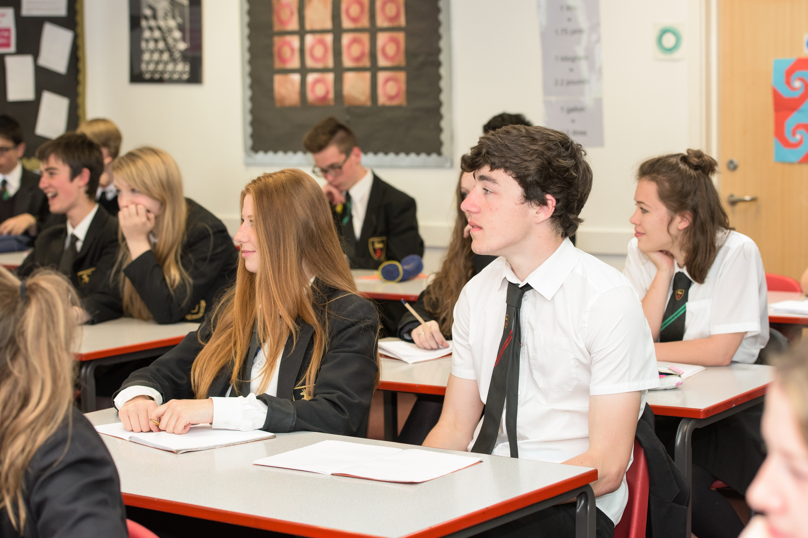
Direction of Travel
Creating a deep learning culture where the default student position is an acceptance of the need to work hard, at home and in class, where the aspirations for success are high.
Notes:
This takes times because we are talking about a shift in culture - but if we continue moving in this direction we will be an outstanding school

Slide 25
Character Education
‘Good character is the foundation for improved attainment and human flourishing.’
Notes:
Importance of character
Basis on assembly rota
Themes of assembly picked up with virtue of the week
Whole school approach
Student leadership opportunities (School council / student librarians / peer supporters / sports leaders / science leaders / senior students)
Charity (defib machine through Healthy Hearts Day / worked with local foodbank during Futures Week)
Whole school approach e.g. Y9 humanitarian trip / battlefields
RIGHT awards

Slide 26
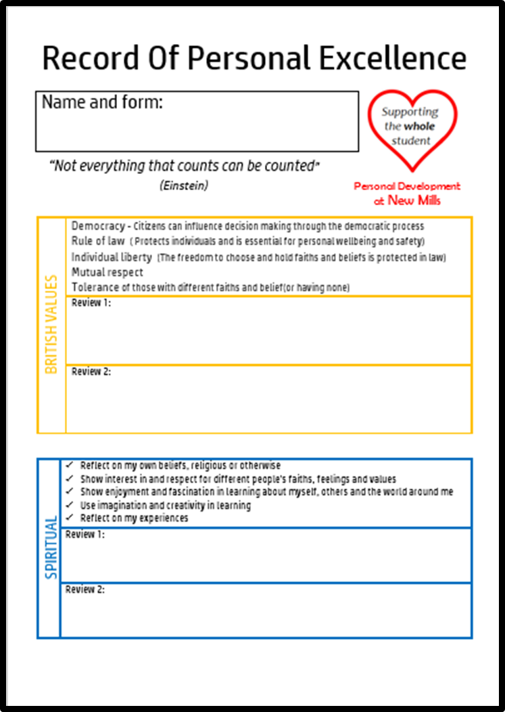
TUTORIAL PROGRAMME
Character education
CEG
Study skills
Numeracy and personal Finance
Literacy
Volunteer week
Silent reading Fridays and
whole school reading week
Notes:
Themes work on a rota (input by staff specialists – Gary and Ali)
Personal finance (basic life skills e.g. opening bank accounts / consumer rights / understanding bank statements and further up the school understanding financial issues associated with higher education)
CEG – world of work / labour market information / enterprise skills / cvs and letters of application – school enterprise link (Lucy Rennie) and DEPB developing links between the school and real employers

Slide 27
CEIAG
Careers Education, Independent Advice and Guidance
How do we support career progression at New Mills School?
CEG tutorials
Careers library and noticeboard
Access to an Independent Career’s Advisor from Y7
E-mail communication between parents, students and the careers advisor
Dedicated careers section on the school website
Recognition of National Careers Week
Year 9 Options Awareness Day
Futures Week and Work Experience

Slide 28
Direction of Travel
Quality and accuracy of assessment
Assessments need to be rigorous and formative – students need to learn from these assessments in order to progress and they should inform future teacher planning
Assessments need to produce reliable data from which we can make accurate judgements about students’ likely outcomes and therefore the necessary interventions within the classroom
With changes to the exam structure, curriculum and pedagogy need to explicitly focus on developing knowledge acquisition and retention and students’ capacity to express their ideas.

Slide 29
The right direction
A culture of high expectations where we do not settle for mediocrity
A deep learning and growth mindset culture where students’ accept that intelligence isn’t fixed and if you work hard you can improve no matter what your starting point
Quality and accurate assessments which provide formative feedback to support students’ improvement and therefore progress
Notes:
The word culture is used a lot because it is only when you shift a culture that you achieve long lasting and sustainable change – there are no quick fixes, this will take time

